Slide 1
Virtual Machines Provisioning and Migration Services
Module 2 (continued)
Rajkumar Buyya, James Broberg, Andrzej Goscinski “Cloud Computing Principles and Paradigms” Wiley Publications , 2013 (Text Book 1)
Barrie Sosinsky“Cloud Computing Bible” Wiley Publications , 2011 (Text Book 2) Chapter 7 to 10

Slide 2
Module 2 (Virtual Machines Provisioning and Migration Services)
Virtual Machines Provisioning and Migration Services: Introduction and Inspiration, Background and Related Work, Virtual Machines Provisioning and Manageability, Virtual Machine Migration Services, VM Provisioning and Migration in Action, Provisioning in the Cloud Context
( Chapter 5 Sections 5.1 to 5.6 of Text Book 1 )
Rajkumar Buyya, James Broberg, Andrzej Goscinski “Cloud Computing Principles and Paradigms” Wiley Publications , 2013 (Text Book 2)

Slide 3
5.1 Introduction
Cloud Computing – Builds on achievements on research areas like SOA, grid computing and virtualization technology
It provides IAAS – based on pay as you use and on-demand computing models to end users.
To provide this service- provisioning of cloud infrastructure in data centers are prerequisite.
This chapter focus on the core services that enable users to get best out of IaaS model in public and private cloud setups which will be more on VM provisioning and migration services.
Notes:
Types of services in SOA
Web services are software systems designed to support interoperable machine-to-machine interaction over a network. This interoperability is gained through a set of XML-based open standards, such as WSDL, SOAP, and UDDI.

Slide 4
Background and Related Work:
5.2.1 Virtualization Technology Overview
Virtualization has revolutionized data center’s technology through a set of techniques and tools that facilitate the providing and management of the dynamic data center’s infrastructure.
Virtualization can be defined as the abstraction of the four computing resources (storage, processing power, memory, and network or I/O).
It is conceptually similar to
Emulation - where a system pretends to be another system,
virtualization - a system pretending to be two or more of the same system .
Virtualization layer will partition the physical resource of the underlying physical server into multiple virtual machines with different workloads.
VM schedules, allocates the physical resource, and makes each virtual machine think that it totally owns the whole underlying hardware’s physical resource (processor, disks, rams, etc.)

Slide 5
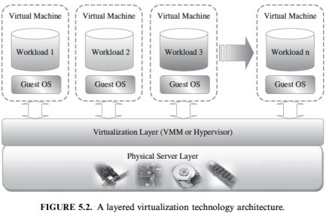
Virtualization layer will partition the physical resource of the underlying physical server into multiple virtual machines with different work loads
Virtual machines technology makes it very flexible and easy to manage the resources in the cloud computing environment because they improve the utilization of the resources by multiplexing many virtual machines on single physical server. These machines can be scaled up and down on demand with high level of resource abstraction

Slide 6
5.2.2 Public Cloud and Infrastructure Services
Here resources are dynamically provisioned via publicly accessible Web applications/Web services (SOAP or RESTful interfaces) from an off-site third-party provider.
The user pays only for the capacity of the provisioned resources at a particular time.
Vendors publicly provide infrastructure as a service.
Examples:
Amazon Elastic Compute Cloud (EC2) , GoGrid, AppNexus , FlexiScale , Manjrasoft ,Aneka etc

Slide 7
5.2.3 Private Cloud and Infrastructure Services
A private cloud aims at providing public cloud functionality, but on private resources.
Private cloud exhibits a highly virtualized cloud data center located inside organization’s firewall.
Private clouds exhibit the following characteristics:
Allow service provisioning and compute capability for an organization’s users in a self-service manner.
Automate and provide well-managed virtualized environments.
Optimize computing resources, and servers’ utilization.
Support specific workloads.
Example providers: Eucalyptus, OpenNebula

Slide 8
The third type of cloud setup named “hybrid cloud,” in which a combination of private/internal and external cloud resources exist together by enabling outsourcing of noncritical services and functions in public cloud and keeping the critical ones internal.
Hybrid cloud’s main function is to release resources from a public cloud and to handle sudden demand usage, which is called “cloud bursting.”
Notes:
Cloud bursting is the practice of dynamically scaling public cloud resources to run workloads when on-premises data center resources are at their peak capacity.

Slide 9
5.2.4 Distributed Management of Virtualization
Many commercial, open source products and research projects such as OpenNebula , IBM Virtualization Manager and VMware are being developed to dynamically provision virtual machines, utilizing the physical infrastructure.
There are also some commercial and scientific infrastructure cloud computing initiatives, such as Globus VWS, Eucalyptus and Amazon, which provide remote interfaces for controlling and monitoring virtual resources.
Virtualization in distributed computing brings flexibility, scalability, portability and cost advantage to an organization.

Slide 10
5.2.5 High Availability
Availability refers to the ability of a user’s community to access the system—whether for submitting new work, updating or altering existing work, or collecting the results of the previous work. If a user cannot access the system, it is said to be unavailable.
This means that services should be available all the time along with some planned/unplanned downtime according to a certain SLA.
In the context of virtualized infrastructure, high availability allows virtual machines to automatically be restarted in case of an underlying hardware failure or individual VM failure.
If one of your servers fails, the VMs will be restarted on other virtualized servers in the resource pool, restoring the essential services with minimal service interruption.
Notes:
A service level agreement (SLA) is an outsourcing and technology vendor contract that outlines a level of service that a supplier promises to deliver to the customer. It outlines metrics such as uptime, delivery time, response time, and resolution time.

Slide 11
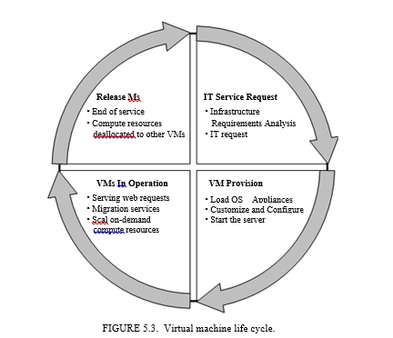
5.3 VIRTUAL MACHINES PROVISIONING AND MANAGEABILITY
The cycle starts by a request delivered to the IT department, stating the requirement for creating a new server for a particular service.
This request is being processed by the IT administration to start seeing the servers’ resource pool, matching these resources with the requirements, and starting the provision of the needed virtual machine.
Once it is provisioned and started, it is ready to provide the required service according to an SLA, or a time period after which the virtual is being released.
4
1
3
2
Notes:
2. SLA

Slide 12
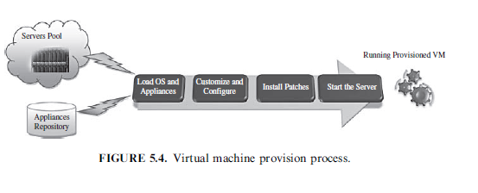
5.3.1 VM Provisioning Process
Provisioning a virtual machine or server can be explained and illustrated as in Figure 5.4

Slide 13
5.3.1 VM Provisioning Process
Steps to Provision VM:
Firstly, we need to select a server from a pool of available servers along with the appropriate OS template we need to provision the virtual machine.
Secondly, we need to load the appropriate software (operating system, device drivers, middleware, and the needed applications for the service required).
Thirdly, we need to customize and configure the machine (e.g., IP address, Gateway) to configure an associated network and storage resources.
Finally, the virtual server is ready to start with its newly loaded software.
Notes:
Why are IP addresses collected?
Every website collects IP addresses, so they're on the server that's powering your site right now. Ironically, one of their main uses is for cyber security

Slide 14
To summarize,
Server provisioning is defining server’s configuration based on the organization requirements, a hardware, and software component (processor, RAM, storage, networking, operating system, applications, etc.).
Normally, virtual machines can be provisioned by manually installing an operating system, by using a preconfigured VM template, by cloning an existing VM, or by importing a physical server or a virtual server from another hosting platform.
After creating a virtual machine by virtualizing a physical server, or by building a new virtual server in the virtual environment, a template can be created out of it.
Most virtualization management vendors (VMware, XenServer, etc.) provide the data center’s administration with the ability to do such tasks in an easy way.
Provisioning from a template is an invaluable feature, because it reduces the time required to create a new virtual machine.
Administrators can create different templates for different purposes. This enables the administrator to quickly provision a correctly configured virtual server on demand.

Slide 15
5.4 VIRTUAL MACHINE MIGRATION SERVICES
Migration service, in the context of virtual machines, is the process of moving a virtual machine from one host server or storage location to another.
Virtual Machine (VM) migration is a powerful management technique that gives data center operators the ability to adapt the placement of VMs in order to better satisfy performance objectives, improve resource utilization and communication locality, mitigate performance hotspots, achieve fault tolerance
There are different techniques of VM migration,
hot/live migration
cold/regular migration
live storage migration
In this process, all key machines’ components, such as CPU, storage disks, networking, and memory, are completely virtualized, thereby facilitating the entire state of a virtual machine to be captured by a set of easily moved data files.
Notes:
VM migration refers to the process of moving a running virtual machine (VM) from one physical host to another, allowing for seamless transfer without disrupting the VM's operations, primarily used for load balancing, disaster recovery, hardware maintenance, cost optimization, and geographic relocation, enabling flexible management of virtualized workloads across different servers without downtime

Slide 16
5.4.1 Migrations Techniques
Live Migration and High Availability:
Live migration (which is also called hot or real-time migration) can be defined as the movement of a virtual machine from one physical host to another while being powered on.
When it is properly carried out, this process takes place without any noticeable effect from the end user’s point of view (a matter of milliseconds).
One of the most significant advantages of live migration is the fact that it facilitates proactive maintenance in case of failure, because the potential problem can be resolved before the disruption of service occurs.
Live migration can also be used for load balancing in which work is shared among computers in order to optimize the utilization of available CPU resources.
Notes:
Live migration is a Hyper-V feature in Windows Server. It allows you to transparently move running Virtual Machines from one Hyper-V host to another without perceived downtime. The primary benefit of live migration is flexibility;
Load balancing involves migration of VMs from highly loaded PMs to under loaded ones. Live migration is used. Live migration requires that both the source and target PMs hosting the VMs have access to the VM's virtual disks

Slide 17
The migration process has been viewed as a transactional interaction between the two hosts involved:
Stage 0: Pre-Migration. An active virtual machine exists on the physical host A.
Stage 1: Reservation. A request is issued to migrate an OS from host A to host B (a precondition is that the necessary resources exist on B and on a VM container of that size).
Stage 2: Iterative Pre-Copy. During the first iteration, all pages are transferred from A to B. Subsequent iterations copy only those pages dirtied during the previous transfer phase.
Stage 3: Stop-and-Copy. Running OS instance at A is suspended, and its network traffic is redirected to B. CPU state and any remaining inconsistent memory pages are then transferred. At the end of this stage, there is a consistent suspended copy of the VM at both A and B. The copy at A is considered primary and is resumed in case of failure.
Notes:
Pre-copy iteratively copies the memory pages of the VM while it is running on the source host until a limit is reached and the VM is stopped and copied to the destination
Dirty page: pages that have been modified(not up to date) and. need to be written back to disk.
A Container is a lightweight, standalone package that encapsulates a complete runtime environment including an application and its dependencie

Slide 18
Stage 4: Commitment. Host B indicates to A that it has successfully received a consistent OS image. Host A acknowledges this message as a commitment of the migration transaction. Host A may now discard the original VM, and Host B becomes the primary host.
Stage 5: Activation. The migrated VM on B is now activated. Post-migration code runs to reattach the device’s drivers to the new machine and advertise moved IP addresses.
With live migration approach to failure management ensures that at least one host has a consistent VM image at all times during migration. It is based on the assumption that the original host remains stable until the migration commits

Slide 19
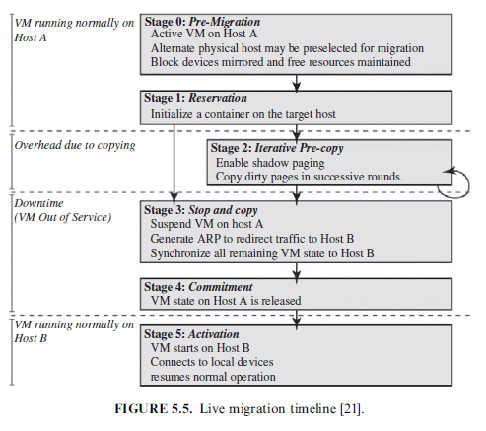
Notes:
A Container is a lightweight, standalone package that encapsulates a complete runtime environment including an application and its dependencie

Slide 20
Cold migration or Regular Migration:
Cold migration is the migration of a powered-off virtual machine.
With cold migration, we have the option of moving the associated disks from one data store to another.
The virtual machines are not required to be on a shared storage.
It’s important to highlight that the two main differences between live migration and cold migration are …
Live migration needs a shared storage for virtual machines in the server’s pool but cold migration shared storage is not required.
In live migration for a virtual machine between two hosts, there would be certain CPU compatibility checks to be applied while in cold migration this checks do not apply.
Cold migration is simple to implement
Notes:
By using cold migration, you can also move associated disks from one datastore to another.
A "CPU compatibility check" in live migration refers to the process of verifying that the source and destination hosts have compatible processors, ensuring a virtual machine can be successfully migrated without disruption, as the CPU instruction set available to the virtual machine must remain consistent between the two hosts during the migration process; if the CPUs are too different, the migration will fail.

Slide 21
Cold migration or Regular Migration:
The steps involved in cold migration are as follows:
The configuration files, including the NVRAM file (BIOS settings), log files, as well as the disks of the virtual machine, are moved from the source host to the destination host’s associated storage area.
The virtual machine is registered with the new host.
After the migration is completed, the old version of the virtual machine is deleted from the source host.

Slide 22
Live Storage Migration :
Live storage migration of Virtual Machine constitutes
moving the virtual disks or configuration file of a running virtual machine to a new data store without any interruption in the availability of the virtual machine’s service.
Notes:
Virtual machine disks can be migrated from one storage domain to another while the virtual machine to which they are attached is running
Live migration lets Google Cloud perform maintenance without interrupting a workload, rebooting a VM, or modifying any of the VM's properties, such as IP addresses, metadata, block storage data

Slide 23
VM Migration, SLA and On-Demand Computing:
virtual machines’ migration plays an important role in data centers by making it easy to adjust resource’s priorities to match resource’s demand conditions.
This role is completely going in the direction of meeting SLAs:
Once it has been detected that a particular VM is consuming more than its fair share of resources at the expense of other VMs on the same host, it will be eligible, for this machine, to either be moved to another underutilized host or assign more resources for it, in case that the host machine still has resources this in turn will highly avoid the violations of the SLA and will also, fulfill the requirements of on-demand computing resources.

Slide 24
VM Migration, SLA and On-Demand Computing:
In order to achieve above said goals, there should be an integration between virtualization’s management tools (with its migrations and performance’s monitoring capabilities), and SLA’s management tools to achieve balance in resources by migrating and monitoring the workloads, and accordingly, meeting the SLA

Slide 25
Migration of Virtual Machines to Alternate Platforms:
One of the nicest advantages of having facility in data center’s technologies is to have the ability to migrate virtual machines from one platform to another;
There are a number of ways for achieving this, such as depending on the source and target virtualization’s platforms and on the vendor’s tools that manage this facility
For example:
the VMware converter that handles migrations between ESX hosts(hypervisor or virtualization platform); the VMware server; and the VMware workstation.
The VMware converter can also import from other virtualization platforms, such as Microsoft virtual server machines

Slide 26
VM PROVISIONING AND MIGRATION IN ACTION:
Now, it is time to get into business with a real example of how we can manage the life cycle, provision, and migrate a virtual machine by the help of one Of the open source frameworks used to manage virtualized infrastructure.
Here, we will use ConVirt (open source framework for the management of open source virtualization ) for example:
ConVirt Deployment Scenario:
ConVirt deployment consists of at least one ConVirt workstation, where ConVirt is installed and ran, which provides the main console for managing the VM life cycle, managing images, provisioning new VMs, monitoring machine resources, and so on
There are two essential deployment scenarios for ConVirt:
(i) basic configuration in which the Xen or KVM virtualization platform is on the local machine, where ConVirt is already installed;
(ii) an advanced configuration in which the Xen or KVM is on one or more remote servers.
The scenario in use here is the advanced one.
Notes:
With the latest version of ConVirt Open Source Version 2.5, management of KVM and Xen-based virtual machines is now possible from an Amazon Web Services (AWS) account.

Slide 27
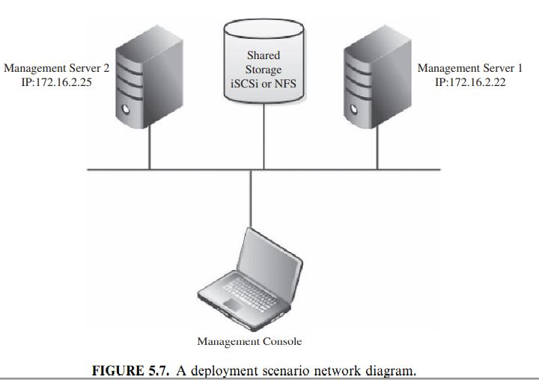
ConVirt installation:
The installation process involves the following:
Installing ConVirt on at least one computer.
Preparing each managed server to be managed by ConVirt.
We have two managing servers with the following Ips (managed server 1, IP:172.16.2.22; and managed server 2, IP:172.16.2.25) as shown in the deployment diagram (Figure 5.7).
Starting ConVirt and discovering the managed servers you have prepared
Notes:
Xen is a hypervisor that runs directly on the system hardware. Xen inserts a virtualization layer between the system hardware and the virtual machines, turning the system hardware into a pool of logical computing resources that Xen can dynamically allocate to any guest operating syste

Slide 28
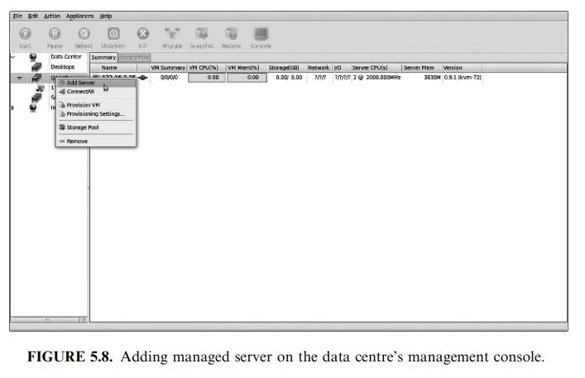
ConVirt installation:
Adding Managed Servers and Provisioning VM: Once the installation is done and you are ready to manage your virtual infrastructure, then you can start the ConVirt management console (see Figure 5.8):
Select any of servers’ pools existing and on its context menu, select “Add Server.”
Notes:
Xen is a hypervisor that runs directly on the system hardware. Xen inserts a virtualization layer between the system hardware and the virtual machines, turning the system hardware into a pool of logical computing resources that Xen can dynamically allocate to any guest operating syste

Slide 29
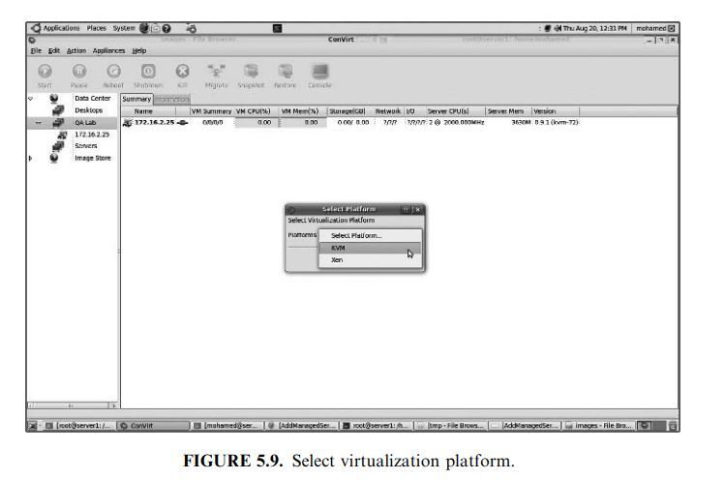
ConVirt installation:
Select any of servers’ pools existing (QA Lab in our scenario) and on its context menu, select “Add Server.”
You will be faced with a message asking about the virtualization platform you want to manage (Xen or KVM), as shown in Figure 5.9:
Notes:
Xen is a hypervisor that runs directly on the system hardware. Xen inserts a virtualization layer between the system hardware and the virtual machines, turning the system hardware into a pool of logical computing resources that Xen can dynamically allocate to any guest operating syste

Slide 30
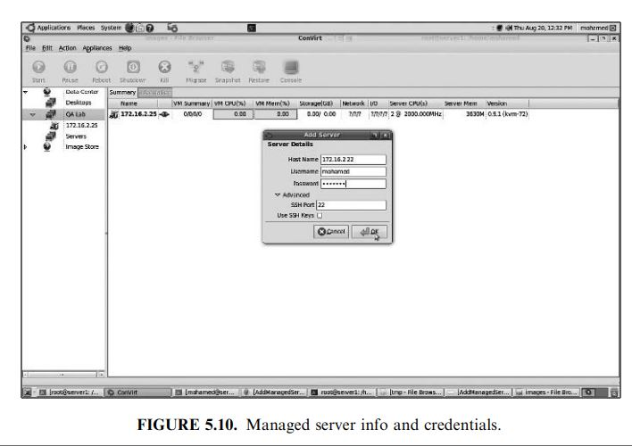
ConVirt installation:
Choose KVM, and then enter the managed server information and credentials (IP, username, and password) as shown in Figure 5.10.
Notes:
Kernel-based Virtual Machine (KVM) is a software feature that you can install on physical Linux machines to create virtual machines
Xen is a hypervisor that runs directly on the system hardware. Xen inserts a virtualization layer between the system hardware and the virtual machines, turning the system hardware into a pool of logical computing resources that Xen can dynamically allocate to any guest operating syste

Slide 31
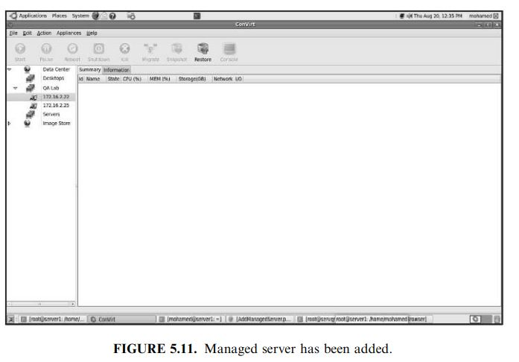
ConVirt installation:
Once the server is synchronized and authenticated with the management console, it will appear in the left pane/of the ConVirt, as shown in Figure 5.11.
Notes:
Xen is a hypervisor that runs directly on the system hardware. Xen inserts a virtualization layer between the system hardware and the virtual machines, turning the system hardware into a pool of logical computing resources that Xen can dynamically allocate to any guest operating syste

Slide 32
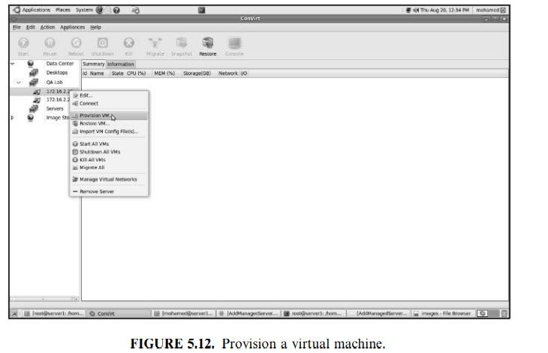
ConVirt installation:
Select this server, and start provisioning your virtual machine as in Figure 5.12:
Notes:
Xen is a hypervisor that runs directly on the system hardware. Xen inserts a virtualization layer between the system hardware and the virtual machines, turning the system hardware into a pool of logical computing resources that Xen can dynamically allocate to any guest operating syste

Slide 33
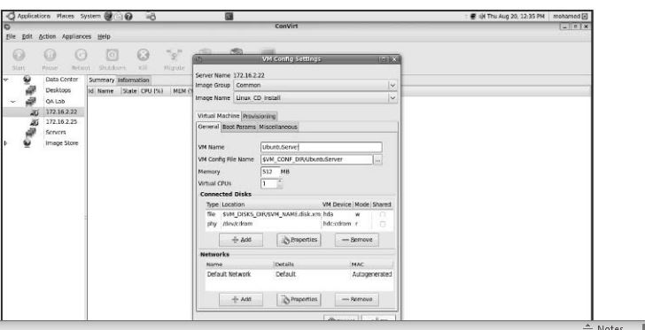
ConVirt installation:
Fill in the virtual machine’s information (name, storage, OS template, etc.; Figure 5.13); then you will find it created on the managed server tree powered-off.
FIGURE 5.13. Configuring virtual machine
Notes:
Xen is a hypervisor that runs directly on the system hardware. Xen inserts a virtualization layer between the system hardware and the virtual machines, turning the system hardware into a pool of logical computing resources that Xen can dynamically allocate to any guest operating syste

Slide 34
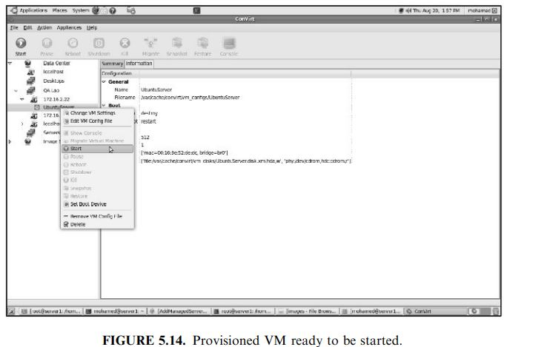
ConVirt installation:
Start your VM (Figures 5.14 and 5.15), and make sure the installation media of the operating system you need is placed in drive, in order to use it for booting the new VM and proceed in the installation process;
Notes:
Xen is a hypervisor that runs directly on the system hardware. Xen inserts a virtualization layer between the system hardware and the virtual machines, turning the system hardware into a pool of logical computing resources that Xen can dynamically allocate to any guest operating syste

Slide 35
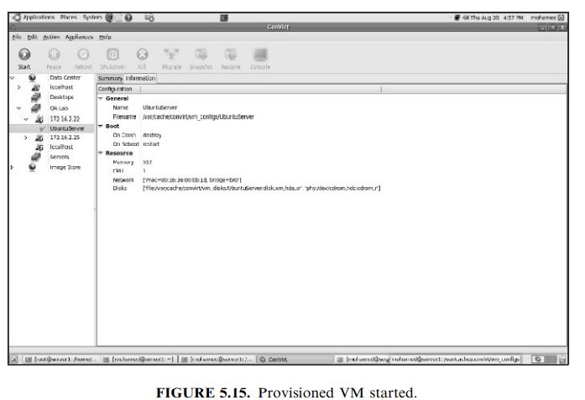
ConVirt installation:
Notes:
Xen is a hypervisor that runs directly on the system hardware. Xen inserts a virtualization layer between the system hardware and the virtual machines, turning the system hardware into a pool of logical computing resources that Xen can dynamically allocate to any guest operating syste

Slide 36
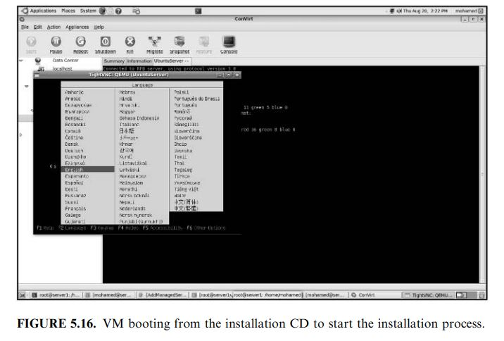
ConVirt installation:
then start the installation process as shown in Figure 5.16.
Once the installation finishes, you can access your provisioned virtual machine from the consol icon on the top of your ConVirt management console.
Reaching this step, you have created your first managed server and provisioned virtual machine. You can repeat the same procedure to add the second managed server in your pool to be ready for the next step of
migrating one virtual machine from one server to the other
Notes:
Xen is a hypervisor that runs directly on the system hardware. Xen inserts a virtualization layer between the system hardware and the virtual machines, turning the system hardware into a pool of logical computing resources that Xen can dynamically allocate to any guest operating syste

Slide 37
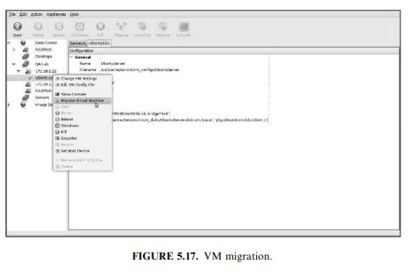
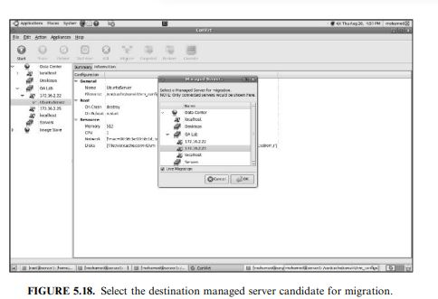
Migration Process in ConVirt:
Migration Process in ConVirt
To start the migration of a virtual machine from one host to the other, select it and choose a migrating virtual machine, as shown in Figure 5.17. You will have a window containing all the managed servers in your data center (as shown in Figure 5.18)
Notes:
Xen is a hypervisor that runs directly on the system hardware. Xen inserts a virtualization layer between the system hardware and the virtual machines, turning the system hardware into a pool of logical computing resources that Xen can dynamically allocate to any guest operating syste

Slide 38
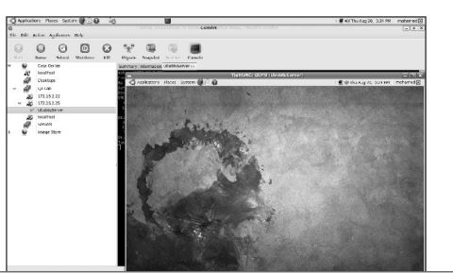
Migration process in ConVirt
Once the virtual machine has been successfully placed and migrated to the destination host, you can see it still living and working (as shown in Figure 5.19).
FIGURE 5.19. VM started on the destination server after migration
Notes:
Xen is a hypervisor that runs directly on the system hardware. Xen inserts a virtualization layer between the system hardware and the virtual machines, turning the system hardware into a pool of logical computing resources that Xen can dynamically allocate to any guest operating syste

Slide 39
5.6 PROVISIONING IN THE CLOUD CONTEXT
In the cloud context, we shall discuss systems that provide the virtual machine provisioning and migration services
Amazon EC2 is a widely known example for vendors that provide public cloud services.
Also, Eucalyptus and OpenNebula are two complementary and enabling technologies for open source cloud tools, which play an invaluable role in infrastructure as a service and in building private, public, and hybrid cloud architecture.

Slide 40
5.6.1 Amazon Elastic Compute Cloud
The Amazon EC2 (Elastic Compute Cloud) is a Web service that allows users to provision new machines into Amazon’s virtualized infrastructure in a matter of minutes; using a publicly available API (application programming interface), it reduces the time required to obtain and boot a new server.
Users get full root access and can install almost any OS or application in their AMIs (Amazon Machine Images).
Web services APIs allow users to reboot their instances remotely, scale capacity quickly, and use on-demand service when needed; by adding tens, or even hundreds, of machines.
It is very important to mention that there is no up-front hardware setup and there are no installation costs, because Amazon charges only for the capacity you actually use.
EC2 instance is typically a virtual machine with a certain amount of RAM, CPU, and storage capacity.

Slide 41
5.6.1 Amazon Elastic Compute Cloud
Amazon EC2 provides its customers with three flexible purchasing models to make it easy for the cost optimization:
(i) On-Demand instances, which allow you to pay a fixed rate by the hour with no commitment.
(ii) Reserved instances, which allow you to pay a low, one-time fee and in turn receive a significant discount on the hourly usage charge for that instance. It ensures that any reserved instance you launch is guaranteed to succeed (provided that you have booked them in advance). This means that users of these instances should not be affected by any transient limitations in EC2 capacity.
(iii) Spot instances, which enable you to bid whatever price you want for instance capacity, providing for even greater savings, if your applications have flexible start and end times
Notes:
In cloud computing, "reserved", "on-demand", and "spot" are three purchasing models with varying levels of flexibility, where "on-demand" offers the most flexibility to instantly access computing power as needed, "reserved" provides significant cost savings by committing to a set amount of capacity for a fixed period, and "spot" allows you to bid for unused compute capacity at a potentially much lower price, but with the risk of interruption if the price rises above your bid.
Key differences:
On-Demand:
Flexibility: Highest flexibility, can scale up or down instantly as needed.
Cost: Most expensive option, pay per hour for usage without any commitment.
Use case: Ideal for unpredictable workloads, testing, or short-term projects where exact resource needs are unknown.
Reserved:
Flexibility: Less flexible than on-demand, requires a long-term commitment to reserve capacity.
Cost: Significant cost savings compared to on-demand due to upfront commitment.
Use case: Best for predictable workloads where you know roughly how much compute power you'll need consistently over a long period.
Spot:
Flexibility: Highly flexible, can take advantage of unused capacity at significantly lower prices.
Cost: Lowest potential cost, but can be interrupted if the price of the spot instance rises above your bid.
Use case: Suitable for cost-sensitive workloads that can tolerate occasional interruptions, like large-scale data processing or batch jobs.
On-Demand vs Reserved vs Spot Instances - Incredibuild
2 Jun 2022 — What are Reserved Instances? Reserved Instances are configured almost exactly like On-Demand Instances. The only differe...
Incredibuild
Spot Instances vs. Reserved Instances: How to Choose - Spot.io
What Are Spot Instances? Spot instances are an option that allows cloud customers to bid for unused compute capacity. They serve a...
Spot.io
AWS Discounts: On Demand vs Reserved Instances vs Spot
There are three different types of RIs: Standard Reserved Instances, Convertible Reserved Instances (which have a smaller discount...
Zesty.co
Show all

Slide 42
Amazon and Provisioning Services
Amazon provides an excellent set of tools that help in provisioning service;
Amazon Auto Scaling [30] is a set of command line tools that allows scaling Amazon EC2 capacity up or down automatically and according to the conditions the end user defines. This feature ensures that the number of Amazon EC2 instances can scale up seamlessly during demand spikes to maintain performance and can scale down automatically when loads diminish and become less intensive to minimize the costs.
Auto Scaling service and CloudWatch [31] (a monitoring service for AWS cloud resources and their utilization) help in exposing functionalities required for provisioning application services on Amazon EC2.
Amazon Elastic Load Balancer [32] is another service that helps in building fault-tolerant applications by automatically provisioning incoming application workload across available Amazon EC2 instances and in multiple availability zones
30. Amazon Auto Scaling Service, http://aws.amazon.com/autoscaling/, March 23, 2010.
31. Amazon CloudWatch Service, http://aws.amazon.com/cloudwatch/, March 23,2010.
32. Amazon Load Balancer Service, http://aws.amazon.com/elasticloadbalancing/.March 21, 2010.
Notes:
Availability zones are multiple, isolated locations within a region, and a region is a geographical location with multiple availability zones mapped within it. Every region is isolated and independent from every other region. By using multiple availability zones, you can keep separate copies of your application and data within separate physical datacenters in a large metropolitan area.

Slide 43
Amazon and Provisioning Services
Amazon Auto Scaling [30]
Why Auto scaling?
AWS Auto Scaling monitors your applications and automatically adjusts capacity to maintain steady, predictable performance at the lowest possible cost.
Using AWS Auto Scaling, it’s easy to set up application scaling for multiple resources across multiple services in minutes.
AWS Auto Scaling makes scaling simple with recommendations that allow you to optimize performance, costs, or balance between them.
With AWS Auto Scaling, your applications always have the right resources at the right time.
30. Amazon Auto Scaling Service, http://aws.amazon.com/autoscaling/, March 23, 2010.
Notes:
Availability zones are multiple, isolated locations within a region, and a region is a geographical location with multiple availability zones mapped within it. Every region is isolated and independent from every other region. By using multiple availability zones, you can keep separate copies of your application and data within separate physical datacenters in a large metropolitan area.

Slide 44
Amazon and Provisioning Services
CloudWatch [31]
Why CloudWatch?
CloudWatch is a service that monitors applications, responds to performance changes, optimizes resource use, and provides insights into operational health. Tracks the health of your AWS resources, including applications, infrastructure, networks, and services
By collecting data across AWS resources, CloudWatch gives visibility into system-wide performance and allows users to set alarms, automatically react to changes, and gain a unified view of operational health.
31. Amazon CloudWatch Service, http://aws.amazon.com/cloudwatch/, March 23,2010.
Notes:
Availability zones are multiple, isolated locations within a region, and a region is a geographical location with multiple availability zones mapped within it. Every region is isolated and independent from every other region. By using multiple availability zones, you can keep separate copies of your application and data within separate physical datacenters in a large metropolitan area.

Slide 45
Amazon and Provisioning Services
Amazon Elastic Load Balancer [32]
What is AWS load balancing? Why?
Elastic Load Balancing automatically distributes your incoming traffic across multiple targets, such as EC2 instances, containers, and IP addresses, in one or more Availability Zones.
It monitors the health of its registered targets, and routes traffic only to the healthy targets. Elastic Load Balancing scales your load balancer capacity automatically in response to changes in incoming traffic.
A load balancer distributes workloads across multiple compute resources, such as virtual servers.
Using a load balancer increases the availability and fault tolerance of your applications.
32. Amazon Load Balancer Service, http://aws.amazon.com/elasticloadbalancing/.March 21, 2010.
Notes:
Availability zones are multiple, isolated locations within a region, and a region is a geographical location with multiple availability zones mapped within it. Every region is isolated and independent from every other region. By using multiple availability zones, you can keep separate copies of your application and data within separate physical datacenters in a large metropolitan area.

Slide 46
Infrastructure Enabling Technology
Offering infrastructure as a service requires software and platforms to manage the Infrastructure being shared and dynamically provisioned.
For this, there are three noteworthy technologies to be considered: Eucalyptus, OpenNebula, and Aneka

Slide 47
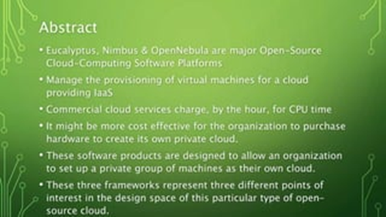

Slide 48
Eucalyptus
Eucalyptus [11] is an open-source infrastructure for the implementation of cloud computing on computer clusters.
It is considered one of the earliest tools developed as a surge computing (in which data center’s private cloud could augment its ability to handle workload’s spikes by a design that allows it to send overflow work to a public cloud) tool.
Its name is an acronym for “elastic utility computing architecture for linking your programs to useful systems.”
Notes:
Eucalyptus is open-source software that allows users to build private and hybrid cloud environments that are compatible with Amazon Web Services (AWS). AWS is a cloud provider that offers a variety of services and features

Slide 49
Eucalyptus
The open-source cloud refers to software or applications publicly available for the users in the cloud to set up for their own purpose or for their organization.
Eucalyptus is a Linux-based open-source software architecture for cloud computing and also a storage platform that implements Infrastructure a Service (IaaS).
It provides quick and efficient computing services.
Eucalyptus was designed to provide services compatible with Amazon’s EC2 cloud and Simple Storage Service(S3).
Notes:
Eucalyptus is open-source software that allows users to build private and hybrid cloud environments that are compatible with Amazon Web Services (AWS). AWS is a cloud provider that offers a variety of services and features

Slide 50
Eucalyptus
Here are some of the Eucalyptus features [11]:
Interface compatibility with EC2, and S3 (both Web service and Query/ REST interfaces).
Simple installation and deployment.
Support for most Linux distributions (source and binary packages).
Support for running VMs that run atop the Xen hypervisor or KVM. Support for other kinds of VMs, such as VMware, is targeted for future releases.
Secure internal communication using SOAP with WS security.
Cloud administrator’s tool for system’s management and user’s accounting.
The ability to configure multiple clusters each with private internal network addresses into a single cloud.
Notes:
Cluster computing aggregates and coordinates a collection of virtual machines (VMs) to work together to perform a task having common goal. Clusters typically have a single head node (sometimes called a controller node), a number of compute nodes, and possibly some specialty nodes

Slide 51
Eucalyptus
Amazon Simple Storage Service (Amazon S3) is an object storage service that offers industry-leading scalability, data availability, security, and performance.
You can use Amazon S3 to store and retrieve any amount of data at any time, from anywhere.
Amazon EC2 is a popular solution for running various applications in the cloud.
However, these applications might need some static data to operate with.
For those use cases, Amazon S3 offers an easy and highly scalable storage for any static data, such as data for website hosting, for example.
Notes:
Amazon Web Services allows its users to build complex interconnected applications in the cloud. To do that, you can use the virtual machines of Amazon EC2 or the expandable storage of Amazon S3.

Slide 52
Eucalyptus
Amazon S3 vs. EC2: What’s Similar, What’s Different?
Amazon EC2 is an instance to access cloud-based servers, while Amazon S3 is used for storing data. However, you might need both of them for your operations.
Amazon EC2 is a popular solution for running various applications in the cloud. However, these applications might need some static data to operate with. For those use cases, Amazon S3 offers easy and highly scalable storage for any static data, such as data for website hosting, for example.
You can set up Amazon S3 buckets as a backup destination for Amazon EC2 data.
Amazon S3 buckets might be used to exchange data between EC2 instances or between the cloud and local infrastructure.
Notes:
Amazon Web Services allows its users to build complex interconnected applications in the cloud. To do that, you can use the virtual machines of Amazon EC2 or the expandable storage of Amazon S3. This article explains in detail what each of the given services does, the difference between them, how you can use Amazon EC2 and Amazon S3 together, and what additional AWS services (such as EFS and EBS) you might wish to use combined with EC2 and S3.

Slide 53
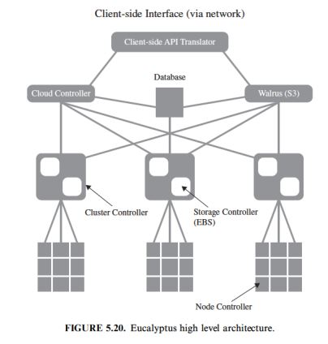
Eucalyptus Architecture
Eucalyptus architecture, as illustrated in Figure 5.20, constitutes each high-level system’s component as a stand-alone Web service with the following high-level components.
Notes:
WALRUS is service for data storage in Eucalyptus that permits clients to store diligent information as objects

Slide 54
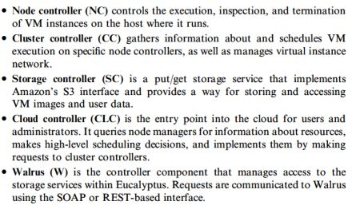
Eucalyptus
Notes:
Storage controler is for persistent data attached to virtual machines, while Walrus is for storing large, unstructured data accessible by any instance across the cloud.
An Amazon S3(simple storage service) bucket is a public cloud storage resource available in Amazon Web Services (AWS) Simple Storage Service (S3) platform
WALRUS is service for data storage in Eucalyptus that permits clients to store diligent information as objects

Slide 55
Eucalyptus
Its design is an open and elegant one.
It can be very beneficial in testing and debugging purposes before deploying it on a real cloud.
For more details about Eucalyptus architecture and design, check reference 11.
Ubuntu Enterprise Cloud and Eucalyptus.:
Ubuntu Enterprise Cloud (UEC) [33] is a new initiative by Ubuntu to make it easier to provision, deploy, configure, and use cloud infrastructures based on Eucalyptus.
UEC brings amazon EC2-like infrastructure’s capabilities inside the firewall.
This is by far the simplest way to install and try Eucalyptus.
Just download the Ubuntu server version and install it wherever you want.
UEC is also the first open source project that lets you create cloud services in your local environment easily and leverage the power of cloud computing.
11. D. Nurmi, R. Wolski, C. Grzegorczyk, G. Obertelli, S. Soman, L. Youseff, D. Zagorodnov, The Eucalyptus Open-source Cloud-computing System, in Proceedings of 9th IEEE International Symposium on Cluster Computing and the Grid,
Shanghai, China, pp. 124131.

Slide 56
VM Dynamic Management Using OpenNebula
OpenNebula [12] is an open and flexible tool that fits into existing data center’s environments to build any type of cloud deployment.
OpenNebula can be primarily used as a virtualization tool to manage your virtual infrastructure, which is usually referred to as private cloud.
OpenNebula supports a hybrid cloud to combine local infrastructure with public cloud-based infrastructure, enabling highly scalable hosting environments.
12. B. Sotomayor, R. Santiago Montero, I. Martı´n Llorente, I. Foster, Capacity Leasing in Cloud Systems using the OpenNebula Engine (short paper). Workshop on Cloud Computing and its Applications 2008 (CCA08), October 2223, 2008,Chicago, Illinois, USA.

Slide 57
VM Dynamic Management Using OpenNebula
OpenNebula also supports public clouds by providing cloud interfaces to expose its functionality for virtual machine, storage, and network management.
OpenNebula supports Xen, KVM, and VMware hypervisors.
OpenNebula architecture is shown in Figure 5.21, which illustrates the existence of public and private clouds and also the resources being managed by its virtual manager.
12. B. Sotomayor, R. Santiago Montero, I. Martı´n Llorente, I. Foster, Capacity Leasing in Cloud Systems using the OpenNebula Engine (short paper). Workshop on Cloud Computing and its Applications 2008 (CCA08), October 2223, 2008,Chicago, Illinois, USA.

Slide 58
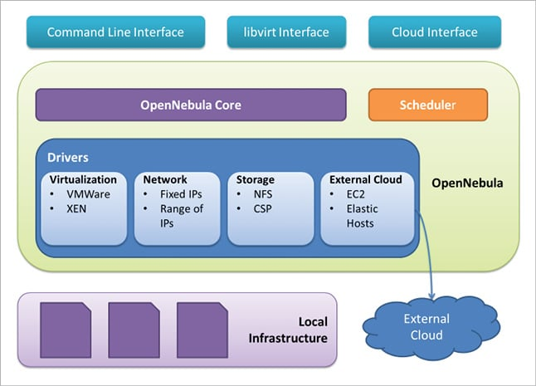
OpenNebula
which illustrates the existence of public and private clouds and also the resources being managed by its virtual manager.
Notes:
The OpenNebula Scheduler is responsible for the planning of the pending Virtual Machines on available hypervisor Nodes. Master nodes and worker nodes

Slide 59
OpenNebula
Components of OpenNebula
Based on the existing infrastructure, OpenNebula provides various services and resources. You can view the components in Figure 3.
APIs and interfaces: These are used to manage and monitor OpenNebula components. To manage physical and virtual resources, they work as an interface.
Hosts and VM resources: These are a key aspect of a heterogeneous cloud that is managed and monitored, e.g., Xen, VMware.
Storage components: These are the basis for centralised or decentralised template repositories.
Network components: These can be managed flexibly. Naturally, there is support for VLANs and Open vSwitch.

Slide 60
OpenNebula
The OpenNebula Scheduler is responsible for planning of the pending Virtual Machines on available hypervisor Nodes.

Slide 61
OpenNebula
OpenNebula is an open-source alternative to these commercial tools for the dynamic management of VMs on distributed resources.
This tool is supporting several research lines in advance reservation of capacity, probabilistic admission control, placement optimization, resource models for the efficient management of groups of virtual machines, elasticity support, and so on.
These research lines address the requirements from both types of clouds namely, private and public

Slide 62
Eucalyptus vs OpenNebula:
What are the differences?
Introduction: Eucalyptus and OpenNebula are two popular cloud computing platforms that provide infrastructure as a service (IaaS) solutions. While they share similar goals, there are several key differences between the two.
Architecture: Eucalyptus is designed to be an on-premise private cloud platform, allowing organizations to build their own cloud infrastructure within their data centers. OpenNebula, on the other hand, is a hybrid cloud platform that supports both on-premise and public cloud deployments. It provides a unified interface to manage resources across different cloud providers. services.

Slide 63
2.Hypervisor Support:
Eucalyptus initially supported only the Xen hypervisor but has now added support for KVM and Vmware
OpenNebula, on the other hand, is hypervisor-agnostic and supports multiple hypervisors including KVM, VMware, and Hyper-V. This flexibility allows users to choose the most suitable hypervisor for their needs.
3. Community and Ecosystem:
OpenNebula has a larger and more active community with regular updates and a wide range of community-contributed plugins and integrations. Eucalyptus, although actively maintained by its community, has a smaller ecosystem.
OpenNebula's larger community translates to more resources, support, and possibilities for customization.

Slide 64
4. Ease of Use:
Eucalyptus aims to provide a user-friendly interface with a web-based dashboard for managing cloud resources.
OpenNebula, although it also has a web-based interface, is more command-line-centric and provides a powerful command-line interface (CLI) for managing and automating cloud deployments.
this makes OpenNebula more suitable for users who prefer CLI-based administration.
5. Multi-Tenancy:
Eucalyptus provides built-in support for multi-tenancy, allowing the segmentation of cloud resources for different users or groups.
OpenNebula also supports multi-tenancy but requires additional configuration and extensions to achieve the same level of segregation.
Eucalyptus offers a simpler and more straightforward approach to multi-tenancy
6. Integration with Other Cloud Services: Eucalyptus integrates well with Amazon Web Services (AWS) and provides an API compatibility layer for existing AWS tools and applications. OpenNebula, on the other hand, focuses on providing a cloud-agnostic platform and does not have specific integration with AWS. This makes Eucalyptus a suitable choice for users who require compatibility with AWS services.

Slide 65
Aneka
Manjrasoft Aneka [10] is a .NET-based platform and framework designed for building and deploying distributed applications on clouds.
It provides a set of APIs for transparently exploiting distributed resources and expressing the business logic of applications by using the preferred programming abstractions.
Aneka is also a market-oriented cloud platform since it allows users to build and schedule applications, provision resources, and monitor results using pricing, accounting, and QoS/SLA services in private and/or public cloud environments
It allows end users to build an enterprise/private cloud setup by exploiting the power of computing resources in the enterprise data centers, public clouds such as Amazon EC2 [4], and hybrid clouds by combining enterprise private clouds managed by Aneka with resources from Amazon EC2 or other enterprise clouds built and managed using technologies such as XenServer.

Slide 66
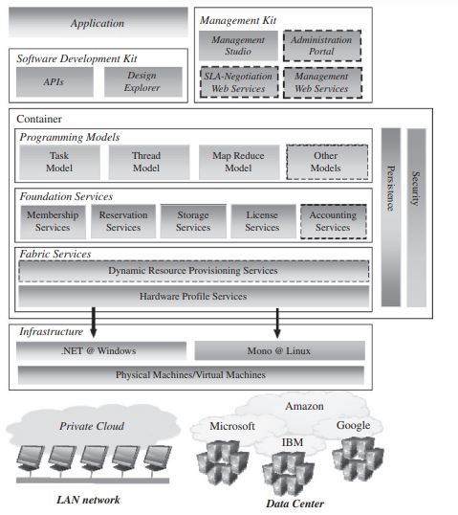
Manjrasoft Aneka layered architecture
Notes:
Aneka Container representing the runtime environment where the distributed applications are executed. The container provides the basic management features of the single node and leverages all the other operations on the services that it is hosting. The services are broken up into fabric, foundation, and execution services.
Fabric services directly interact with the node through the Platform Abstraction Layer (PAL) and perform hardware profiling and dynamic resource provisioning
. Foundation services identify the core system of the Aneka middleware, providing a set of basic features to enable Aneka containers to perform specialized and specific sets of tasks.
Execution services directly deal with the scheduling and execution of applications in the Cloud.

Slide 67
Aneka
Fabric services: represent the basic part of the infrastructural framework through which the resources of the cloud environment can be managed and automated. They involve the physical or low level of resource provision and allocation and also virtualization.
Fabric services are to provide computational assets such as virtual machines, networking, storage management etc
Foundation Services: As you move up in the stack, foundation services rely on the fabric layer and provide further enhancement for the development of applications in the distributed environment such as data management, security and authentication
Programming service: directly deals with the scheduling and execution of applications in the Cloud which includes Task-mode, Thread model, Map Reduce model etc
Application Services: they represent typical application templates or scenarios that can help to promote application assembly. This includes data analytics and ML, IoT integration etc.

Slide 68
About Docker Container
Module 2 (continued)
Material from relevant papers

Slide 69
Need of Docker container
Docker is an open platform for developing, shipping, and running applications within “containers”
Docker enables you to separate your applications from your infrastructure so you can deliver software quickly.
Containers and VMs are similar in their goals: to isolate an application and its dependencies into a self-contained unit that can run anywhere.
Moreover, containers and VMs remove the need for physical hardware, allowing for more efficient use of computing resources, both in terms of energy consumption and cost effectiveness.
The main difference between containers and VMs is in their architectural approach.
Notes:
Docker Engine is the fundamental containerization engine that runs on servers and manages container.
A "container" in Docker Engine is a lightweight, isolated runtime environment that packages an application with all its dependencies

Slide 70
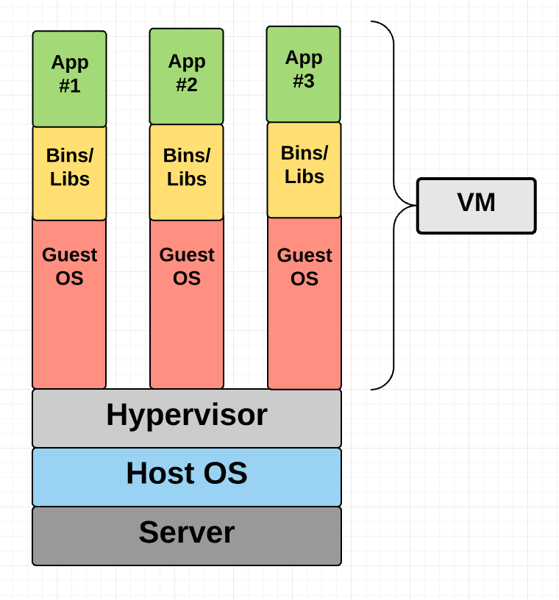
Need of Docker container
What is the difference between containers and VMs?
VM has a virtual operating system of its own, the hypervisor plays an essential role in providing the VMs with a platform to manage and execute this guest operating system. It allows for host computers to share their resources amongst the virtual machines that are running as guests on top of them.
Notes:
Containers are a form of operating system virtualization. A single container might be used to run anything from a small microservice or software process to a larger application. They are an abstraction at the app layer that package code and dependencies together. The containers share the host OS kernel and, usually, the binaries and libraries, too

Slide 71
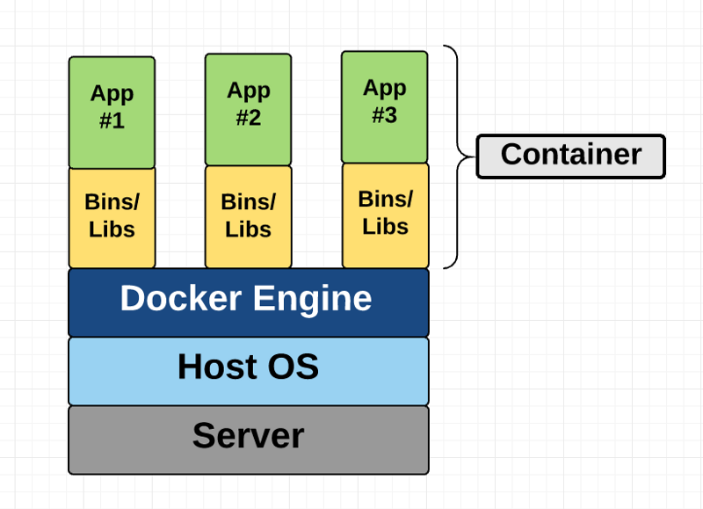
Need of Docker container
What is the difference between containers and VMs?
Unlike a VM which provides hardware virtualization, a container provides operating-system-level virtualization by abstracting the “user space”.
The one big difference between containers and VMs is that containers *share* the host system’s kernel with other containers
Unlike VM, application is managed by Host OS , not by separate Guest OS
Notes:
The five basic components of Linux are:
Kernel: The core of the operating system that interacts with hardware and provides low-level services (KUH-NUHL)
Shell: An interface that takes user commands and executes kernel functions
System libraries: A set of functions that applications can use
System utilities: Programs that perform various tasks
Graphical user interface: The overall user interface, which includes the window manager

Slide 72
 | Container | Virtual Machines (VMs)
Boot-Time | Boots in a few seconds. | It takes a few minutes for VMs to boot.
Runs on | Dockers make use of the execution engine. | VMs make use of the hypervisor.
Memory Efficiency | No space is needed to virtualize, hence less memory. | Requires entire OS to be loaded before starting the surface, so less efficient.
Isolation | Prone to adversities as no provisions for isolation systems. | Interference possibility is minimum because of the efficient isolation mechanism.
Deployment | Deploying is easy as only a single image, containerized can be used across all platforms. | Deployment is comparatively lengthy as separate instances are responsible for execution.
Performance | Better performance | Native performance
Need of Docker container

Slide 73
Need of Docker container
Where does Docker come in?
Docker is an open-source project based on Linux containers.
It uses Linux Kernel features like namespaces and control groups to create containers on top of an operating system.
Containers are far from new; Google has been using their own container technology for years.
Others Linux container technologies include Solaris Zones, BSD jails, and LXC, which have been around for many years.
Notes:
KUH-NUHL

Slide 74
Benefits of Docker
Ease of use:
Docker has made it much easier for anyone — developers, systems admins, architects and others — to take advantage of containers in order to quickly build and test portable applications.
It allows anyone to package an application on their laptop, which in turn can run unmodified on any public cloud, private cloud, or even bare metal. The mantra is: “build once, run anywhere.”
2. Speed:
Docker containers are very lightweight and fast. Since containers are just sandboxed environments running on the kernel, they take up fewer resources.
You can create and run a Docker container in seconds, compared to VMs which might take longer because they have to boot up a full virtual operating system every time.

Slide 75
Benefits of Docker
3. Docker Hub:
Docker users also benefit from the increasingly rich ecosystem of Docker Hub, which you can think of as an “app store for Docker images.”
Docker Hub has tens of thousands of public images created by the community that are readily available for use. It’s incredibly easy to search for images that meet your needs, ready to pull down and use with little-to-no modification.
4. Modularity and Scalability:
Docker makes it easy to break out your application’s functionality into individual containers.
For example, you might have your Postgres database running in one container and your Redis server in another while your Node.js app is in another. With Docker, it’s become easier to link these containers together to create your application, making it easy to scale or update components independently in the future.

Slide 76
Lab materials
Introduction to Azure - Training | Microsoft Learn (A content which I have co created with few teammates.Provides a gist of development tools and Azure)
Collections | Microsoft Learn (For working on projects)
Azure for Students – Free Account Credit | Microsoft Azure (Link which i used to signup for credits)
Student Hub - Student Certifications | Microsoft Learn (Browsing Certifications)
Microsoft Azure Fundamentals: Describe cloud concepts - Training | Microsoft Learn
Microsoft Azure Fundamentals: Describe Azure architecture and services - Training | Microsoft Learn
Microsoft Azure Fundamentals: Describe Azure management and governance - Training | Microsoft Learn
( The links in 5,6,7 are all the materials i had used in the workshop.Can be used for AZ-900 Exam preparation)
Create a Windows virtual machine in Azure - Training | Microsoft Learn
Host a web application with Azure App Service - Training | Microsoft Learn
Create intelligent health bots with Azure Health Bot - Training | Microsoft Learn (Health bot SAAS,Includes)

Slide 77
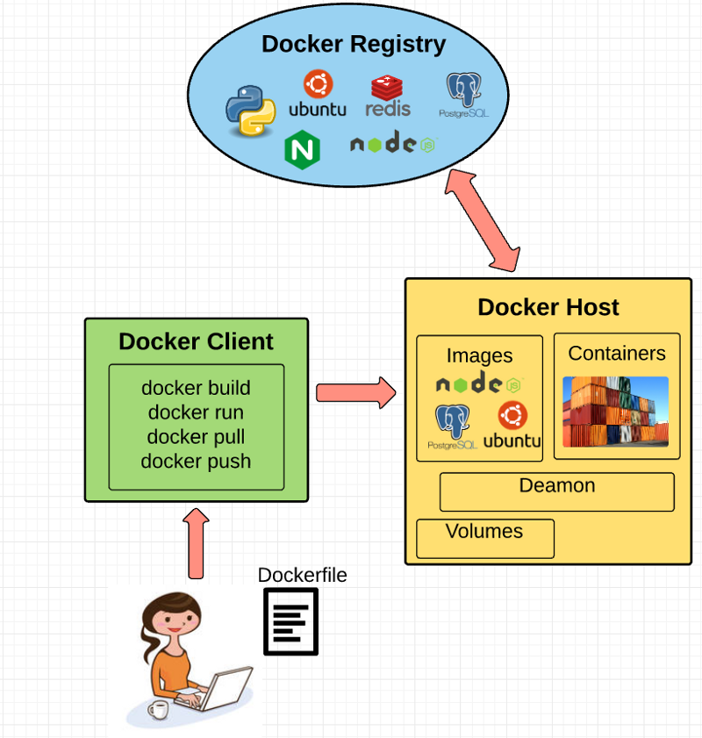
Fundamental Docker Concepts
Docker Engine
Docker engine is the layer on which Docker runs.
It’s a lightweight runtime and tooling that manages containers, images, builds, and more.
Notes:
"Docker daemon" refers specifically to the background process that manages Docker containers, while "Docker Engine" encompasses the entire system including the daemon, the CLI client, and the API used to interact with it; essentially, the Docker daemon is a core component of the Docker Engine.

Slide 78
Fundamental Docker Concepts
1. A Docker Daemon that runs in the host computer. 2. A Docker Client that then communicates with the Docker Daemon to execute commands. 3. A REST API for interacting with the Docker Daemon remotely.

Slide 79
Need of Docker container
Fundamental Docker Concepts
Docker Client
The Docker Client is what you, as the end-user of Docker, communicate with.
Think of it as the UI for Docker. For example, when you do… you are communicating to the Docker Client, which then communicates your instructions to the Docker Daemon

Slide 80
Need of Docker container
Fundamental Docker Concepts
Docker Daemon
The Docker daemon is what actually executes commands sent by the Docker Client — like building, running, and distributing your containers.
The Docker Daemon runs on the host machine, but as a user, you never communicate directly with the Daemon.
The Docker Client can run on the host machine as well, but it’s not required to. It can run on a different machine and communicate with the Docker Daemon that’s running on the host machine.

Slide 81
Need of Docker container
Fundamental Docker Concepts
Dockerfile
A Dockerfile is where you write the instructions to build a Docker image.
These instructions can be:
• RUN apt-get y install some-package: to install a software package
• EXPOSE 8000: to expose a port
• ENV ANT_HOME /usr/local/apache-ant to pass an environment variable
and so forth. Once you’ve got your Dockerfile set up, you can use the docker build command to build an image from it.
Here’s an example of a Dockerfile:

Slide 82
Sample Dockerfile
# Use the official Python image as a base
FROM python:3.9-slim-buster
# Set environment variables
ENV PYTHONUNBUFFERED 1
ENV FLASK_APP=app.py
ENV FLASK_RUN_HOST=0.0.0.0
# Set the working directory in the container
WORKDIR /app
# Copy the requirements file and install dependencies
COPY requirements.txt requirements.txt
RUN pip install -r requirements.txt
# Copy the application code into the container
COPY . /app
# Expose port 5000 to the outside world
EXPOSE 5000
# Run the Flask app when the container launches
CMD ["flask", "run"]

Slide 83
Docker Image
Images are read-only templates that you build from a set of instructions written in your Dockerfile.
Images define both what you want your packaged application and its dependencies to look like *and* what processes to run when it’s launched.
The Docker image is built using a Dockerfile. Each instruction in the Dockerfile adds a new “layer” to the image, with layers representing a portion of the images file system that either adds to or replaces the layer below it.

Slide 84
Docker Containers
A Docker container, as discussed above, wraps an application’s software into an invisible box with everything the application needs to run.
That includes the operating system, application code, runtime, system tools, system libraries, and etc.
Docker containers are built on Docker images.

Slide 85
Using a REST API with Docker allows you to containerize your API application, meaning you can package it with all its dependencies and easily deploy it across different environments by running the Docker container, making it highly portable and scalable; essentially, you can treat your REST API as a self-contained unit managed by Docker
How to set up a REST API with Docker:
1. Create your API code:
Develop your REST API using your preferred framework (like Express.js, Flask, Spring Boot).
2. Write a Dockerfile:
Define the steps to build your API environment in a Dockerfile, including installing dependencies, copying your code, and specifying the command to start your API server.
3.Build the image:
Run docker build to create a Docker image based on your Dockerfile.
4. Run the container:
Use docker run to start your API container, specifying the port to expose and any necessary environment variables.

Slide 86
Step 1: Install docker. Download the docker installer from https://docs.docker.com/desktop. ...
Step 2: Install python and flask.
Step 3: Create flask API. ...
Step 4: Run and Test. ...
Step 5: Generate requirements file. ...
Step 6: Create dockerfile. ...
Step 7: Build and run the docker image. ...
Step 8: Push and pull Docker images (optional)

Slide 87
Docker Eco-System
Docker eco system is a set of software or packages required to build container. It includes
1. Docker daemon
2. Docker client
3. Docker hub
4. Docker images
5. Docker host

Slide 88
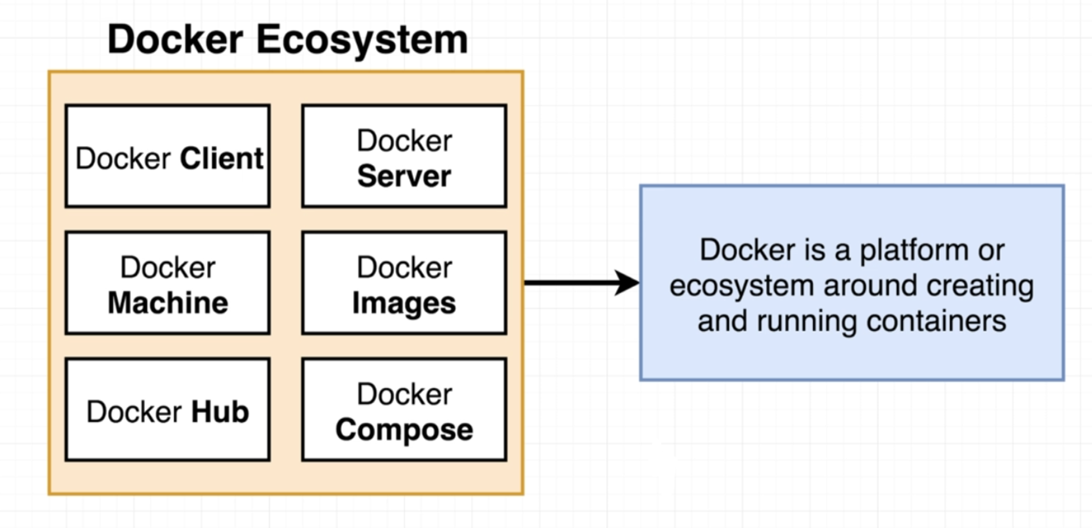
Docker Eco-System

Slide 89
Docker Eco-System
Docker daemon/server/engine :
Docker deamon runs on the host OS.
It is responsible for running containers and manages docker services.
Docker daemon can communicate with other daemons. It converts your image into container.
Docker Client :
Docker user can interact with Docker daemon/server through a client.
Docker client uses commands and REST API to communicate with the Docker daemon.
Notes:
Docker Compose is a tool that helps you define and run multi-container Docker applications

Slide 90
Docker Eco-System
Docker daemon/server/engine :
Docker Host :
Docker Host provides an environment to execute and run applications.
It contains docker daemon, images, containers, networks and storages.
Docker Hub/Registry
Docker registry/hub manages (keeps images category wise) and stores Docker images. There are two types of registries in the Docker.
1. Public Registry – is also called as Docker hub. It is accessible for everyone.
2. Private Registry – is used to share images within the enterprise
Docker Images
are the read only binary templates used to create Docker containers

Slide 91
Docker Eco-System
Docker Container – Holds entire packages needed to run application or in other words,
we can say that, the image is a template and the container is a running form of that template.
Container is like a virtual machine.
Images become container when they are run on Docker engine.
Notes:
Docker Container is equivalent to active VM(Virtual Server, Virtual Desktop etc)
Docker Image is VM template

Slide 92
Docker Eco-System
Creating container from a Dockerfile
Follow these steps to create a container from Dockerfile
1. Create a file named Dockerfile
2. Add instructions in file
3. Build Dockerfile to create image
4. Run image to create a container

Slide 93
Hadoop MapReduce
Module 2 (continued)
From relevant sources

Slide 94
Platform For Managing Big Data - Hadoop
Hadoop is an open-source software framework that supports scalable distributed applications . It uses distributed storage and parallel processing to handle big data and analytics jobs.
Hadoop supports running applications on large clusters of commodity hardware and provide fast and reliable analysis of both structured and unstructured data.
HDFS uses the MapReduce method, an application programming model developed by Google, which provides two fundamental operations for data processing: map and reduce.
Map - transforms and synthesizes the input data provided by the user;
Reduce - aggregates the output obtained by the map operations
Hadoop uses simple programming model.
Hadoop can scale from single servers to thousands of machines, each offering local computation and storage.
Hadoop Distributed File System design is based on the design of Google File System. It’s notion is “Write Once Read Multiple times”.
Notes:
HDFS applications need a write-once-read-many access model for files. A file once created, written, and closed need not be changed

Slide 95
Hadoop MapReduce
MapReduce is a big data analysis model that processes data sets using a parallel algorithm on computer clusters, typically Apache Hadoop clusters or cloud systems like Amazon Elastic MapReduce (EMR) clusters.
A software framework and programming model called MapReduce is used to process enormous volumes of data( Big Data).
Notes:
An Apache Hadoop cluster is a group of computers that work together to store, process, and analyze large amounts of data. Apache Hadoop is an open-source framework that uses multiple computers to process data in parallel.
Amazon EMR is a cloud big data platform for running large-scale distributed data processing jobs, interactive SQL queries, and machine learning applications

Slide 96
Why HDFS works very well with Big Data?
HDFS uses the MapReduce method for access to data which is very fast.
It follows a data coherency model (data is coherent means, data on the server and all the clients is synchronized)that is simple to implement highly robust and scalable models…
Compatible with any kind commodity hardware and operating system processor.
Economy is been achieved by distributing data and processing on clusters with parallel nodes
Data is always safe as it is automatically saved in multiple locations for safe secure.
It provides a JAVA API’s and C language is on the top priority.
It is easily accessible using a web browser making it highly effective.
Notes:
HDFS: HDFS" (Hadoop Distributed File System) is a key component of Hadoop that acts as a distributed file system designed to manage massive data sets across multiple nodes on a cluster,

Slide 97
Hadoop MapReduce
What is Big Data?
Big Data is a collection of large datasets that cannot be processed using traditional computing techniques.
For example, the volume of data Facebook or Youtube need require it to collect and manage on a daily basis, can fall under the category of Big Data.
However, Big Data is not only about scale and volume, it also involves one or more of the following aspects −4 V’s: Velocity, Variety, Volume, and Veracity
Notes:
Volume The amount of data collected. Velocity How quickly data is produced. For example, how fast stock market data updates
Variety The range of types of data Veracity How accurate and truthful the data is. For example, how much control a company has over the data-gathering process.
Data veracity refers to the biasedness, noise, and abnormality in data.

Slide 98
Hadoop MapReduce
Why MapReduce?
Traditional Enterprise Systems normally have a centralized server to store and process data.
The following illustration depicts a schematic view of a traditional enterprise system.
Traditional model is certainly not suitable to process huge volumes of scalable data and cannot be accommodated by standard database servers.
Moreover, the centralized system creates too much of a bottleneck while processing multiple files simultaneously.
Notes:
centralized system relies on a single point of processing, which can become overloaded when dealing with massive data volumes;

Slide 99
Hadoop MapReduce
How MapReduce Works?
The MapReduce algorithm contains two important tasks, namely Map and Reduce.
• The Map task takes a set of data and converts it into another set of data, where individual elements are broken down into tuples (key-value pairs).
• The Reduce task takes the output from the Map as an input and combines those data tuples (key-value pairs) into a smaller set of tuples.
The reduce task is always performed after the map job.
Let us now take a close look at each of the phases and try to understand their significance.

Slide 100
Hadoop MapReduce
How MapReduce Works?

Slide 101
How MapReduce Works?
Input Phase − Here we have a Record Reader that translates each record in an input file and sends the parsed data to the mapper in the form of key-value pairs
• Map − Map is a user-defined function, which takes a series of key-value pairs and processes each one of them to generate zero or more key-value pairs.
• Intermediate Keys − They key-value pairs generated by the mapper are known as intermediate keys.
• Combiner − A combiner is a type of local Reducer that groups similar data from the map phase into identifiable sets. It takes the intermediate keys from the mapper as input and applies a user-defined code to aggregate the values in a small scope of one mapper. It is not a part of the main MapReduce algorithm; it is optional.
• Shuffle and Sort − The Reducer task starts with the Shuffle and Sort step. It downloads the grouped key-value pairs onto the local machine, where the Reducer is running.
The individual key-value pairs are sorted by key into a larger data list. The data list groups the equivalent keys together so that their values can be iterated easily in the Reducer task.

Slide 102
Hadoop MapReduce
How MapReduce Works?
Reducer − The Reducer takes the grouped key-value paired data as input and runs a Reducer function on each one of them.
Here, the data can be aggregated, filtered, and combined in a number of ways, and it requires a wide range of processing. Once the execution is over, it gives zero or more key-value pairs to the final step.
• Output Phase − In the output phase, we have an output formatter that translates the final key-value pairs from the Reducer function and writes them onto a file using a record writer.

Slide 103
Let us try to understand the two tasks Map & Reduce with the help of a small diagram
Notes:
eBay Inc. is an American multinational e-commerce corporation based in San Jose, California, that facilitates consumer-to-consumer and business-to-consumer sales through its website. eBay was founded by Pierre Omidyar in 1995, and became a notable success story of the dot-com bubble.

Slide 104
Hadoop MapReduce
The Wordcount Example
The Wordcount application counts the number of occurrences of each word in a large collection of documents.
The steps of the process are briefly described as follows:
⇨ The input is read and broken up into key/value pairs (e.g., the Map function emits a word and its associated count of occurrence, which is just “1”).
⇨ The pairs are partitioned into groups for processing, and they are sorted according to their key as they arrive for reduction.
⇨ Finally, the key/value pairs are reduced, once for each unique key in the sorted list, to produce a combined result (e.g., the Reduce function sums all the counts emitted for a particular word).

Slide 105
Hadoop MapReduce
The Wordcount Example
.
Notes:
Data veracity refers to the biasedness, noise, and abnormality in data.

Slide 106
Hadoop MapReduce
The Wordcount Example
.
Notes:
Data veracity refers to the biasedness, noise, and abnormality in data.

Slide 107
Hadoop MapReduce
The Wordcount Example
.
# Reducer.py
from operator import itemgetter
import sys
current_word = None
current_count = 0
word = None
# input comes from STDIN
for line in sys.stdin:
# remove leading and trailing whitespace
line = line.strip()
# parse the input we got from mapper.py
word, count = line.split('\t', 1)
# convert count (currently a string) to int
try:
count = int(count)
except ValueError:
# count was not a number, so silently
# ignore/discard this line
continue
# this IF-switch only works because Hadoop sorts map output
# by key (here: word) before it is passed to the reducer
if current_word == word:
current_count += count
else:
if current_word:
# write result to STDOUT
print('%s\t%s' % (current_word, current_count) )
current_count = count
current_word = word
# do not forget to output the last word if needed!
if current_word == word:
print('%s\t%s' % (current_word, current_count))
# mapper.py
import sys
# input comes from STDIN (standard input)
for line in sys.stdin:
# remove leading and trailing whitespace
line = line.strip()
# split the line into words
words = line.split()
# increase counters
for word in words:
# write the results to STDOUT (standard output);
# what we output here will be the input for the
# Reduce step, i.e. the input for reducer.py #
# tab-delimited; the trivial word count is 1
print("%s\t\t%s" %(word, 1))

Slide 108
OUTPUT-1
Las Vegas 208.97
Miami 84.11
Tucson 489.93
San Francisco 388.3
Dallas 145.63
Tampa 353.23
Washington 481.31
San Jose 492.8
Newark 410.37
Memphis 354.44
Jersey City 369.07
Plano 4.65
Buffalo 337.35
Louisville 213.64
Miami 154.64
Los 164.5
Birmingham 1.64
Mesa 13.79
Wichita 158.25
Indianapolis 152.77
San Bernardino 332.43
Indianapolis 464.36
Stockton 180.61
Hadoop MapReduce
Write a map reduce program that returns the cost of the item that is most expensive, for each location in the dataset example.txt
Note: Input for this program is example.txt file.

Slide 109
OUTPUT-1
Las Vegas 208.97
Miami 84.11
Tucson 489.93
San Francisco 388.3
Dallas 145.63
Tampa 353.23
Washington 481.31
San Jose 492.8
Newark 410.37
Memphis 354.44
Jersey City 369.07
Plano 4.65
Buffalo 337.35
Louisville 213.64
Miami 154.64
Los 164.5
Birmingham 1.64
Mesa 13.79
Wichita 158.25
Indianapolis 152.77
San Bernardino 332.43
Indianapolis 464.36
Stockton 180.61
Austin 48.09
Buffalo 386.56
Santa Ana 2.75
Gilbert 11.31
New York 221.35
Hadoop MapReduce
Write a map reduce program that returns the cost of the item that is most expensive, for each location in the dataset example.txt
Note: Input for this program is example.txt file.

Slide 110
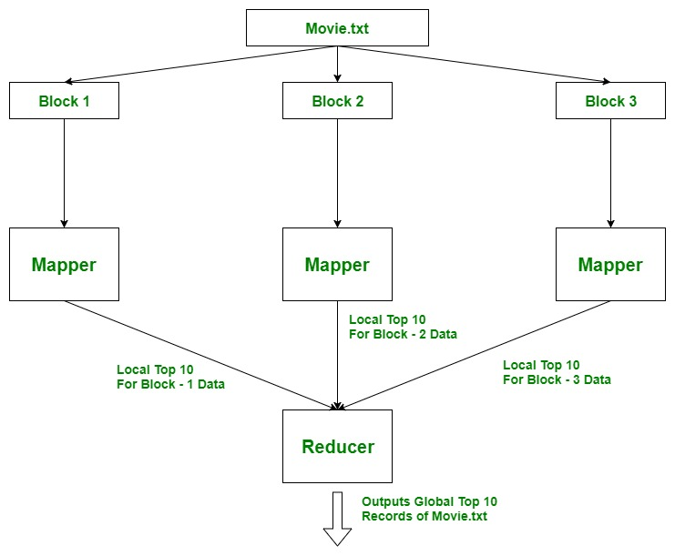
Finding top 10 or 20 records from a large dataset is the heart of many recommendation systems and it is also an important attribute for data analysis.

Slide 111
Approach Used: Using TreeMap. Here, the idea is to use Mappers to find local top 10 records, as there can be many Mappers running parallelly on different blocks of data of a file. And then all these local top 10 records will be aggregated at Reducer where we find top 10 global records for the file.
Notice: This approach only work if we assume that 2 movie can not have the same number of views. Otherwise, only one of those two movie will be returned.
Example: Assume that file(30 TB) is divided into 3 blocks of 10 TB each and each block is processed by a Mapper parallelly so we find top 10 records (local) for that block. Then this data moves to the reducer where we find the actual top 10 records from the file movie.txt.

Slide 112
The mapper processes one key-value pair at a time and writes them as intermediate output on local disk.
But we have to process whole block (all key-value pairs) to find top10
In Hadoop, HDFS (Hadoop Distributed File System) is primarily used to store large datasets across a cluster of computers, allowing for distributed storage and efficient access to massive amounts of data, particularly big data, by breaking files into blocks and distributing them across multiple nodes for parallel processing; essentially, it acts as the primary data storage mechanism within the Hadoop ecosystem.
The large text file is initially stored in HDFS, distributed across multiple nodes in a cluster for redundancy and parallel processing.
The final outcome of a MapReduce job in Hadoop will be stored on the Hadoop Distributed File System (HDFS).

Slide 113
Exploring PaaS
Module 2 (continued)
Barrie Sosinsky“Cloud Computing Bible” Wiley Publications , 2011 (Text Book 2) Chapter 7

Slide 114
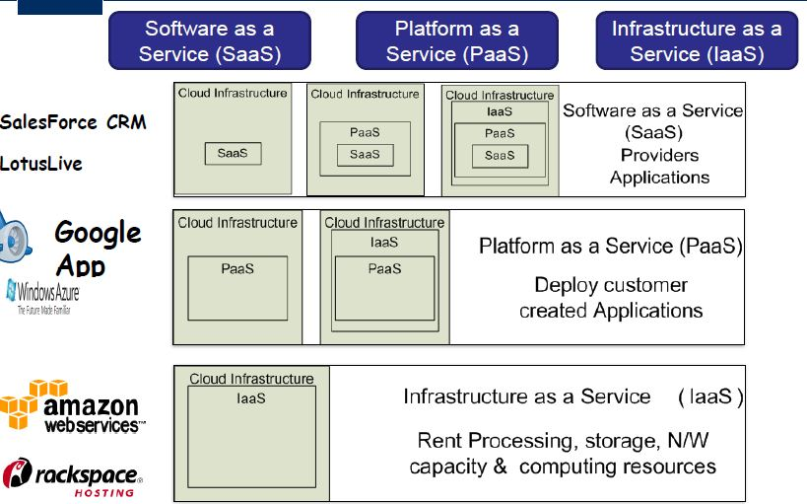
Notes:
IaaS; Means delivering Cloud infrastructure as on demand services, is one of the fundamental cloud model. It allows dynamic scaling and resources are distributed
PaaS: Is a cloud delivery model for applications composed of services managed by third party. It provides elastic scaling of your applications which allow developers to build applications over the Internet. Is also known as application PaaS.It helps in maintaining and organizing the of the useful applications
SaaS: Allows users to run existing online applications. SaaS services are used for the development and deployment of modern applications. It allows the software and its functions to be accessed from anywhere ith good Internet connection and a browser
SaaS offers ready-to-use, out-of-the-box solutions that meet a particular business need (such as a website or email). Most modern SaaS platforms are built on IaaS or PaaS platforms

Slide 115
Exploring PaaS
The Platform as a Service model provides the tools within an environment needed to create applications that can run in a Software as a Service model.
• For this reason, some overlap between vendors has created Software as a Service products, and those vendors have broadened their services to make their web applications more customizable.
For Example: Salesforce.com and Force.com
•Salesforce.com" refers to Salesforce's primary Software-as-a-Service (SaaS) offering, which provides readily accessible CRM applications like Sales Cloud and Service Cloud, while "Force.com" is the name for their Platform-as-a-Service (PaaS) platform, allowing users to build custom applications on top of the Salesforce infrastructure using tools like Apex code
Notes:
Customer Relationship Management (CRM)
Integrated lifecycle PaaS provides all of the capabilities that you need to support the complete web application lifecycle: building, testing, deploying, managing, and updating within the same integrated environment.
Anchored: based on business logic at the center of the approach.

Slide 116
Exploring PaaS
• Applications developed in PaaS systems can be composite business applications, data portals, or mashups with data derived from multiple sources.
• PaaS environments can offer integrated lifecycle management or anchored lifecycle applications
• An integrated system provides a broad range of tools for customization, whereas an anchored system is based on already established software
Integrated lifecycle PaaS provides all of the capabilities that you need to support the complete web application lifecycle: building, testing, deploying, managing, and updating within the same integrated environment.
Notes:
Integrated lifecycle PaaS provides all of the capabilities that you need to support the complete web application lifecycle: building, testing, deploying, managing, and updating within the same integrated environment.
Anchored: based on business logic at the center of the approach.

Slide 117

PaaS models span a broad ran#e of services, includin# these, amon# others)*
App'(cat("$ )e*e'"pme$t+
$ PaaS platform either provides the means to usepro#rams %ou create in a supported lan#ua#e or o&ers a visual developmentenvironment that writes the code for %ou.*
C"''a"rat("$+
+an% PaaS s%stems are set up to allow multiple individuals towor on the same proects.*
Data ma$aeme$t+
Tools are provided for accessin# and usin# data in a datastore.*
I$trume$tat("$, per"rma$ce, a$) tet($+
Tools are available formeasurin# %our applications and optimi"in# their performance.*
-t"rae+
'ata can be stored in either the PaaS vendor-s service or accessedfrom a thirdpart% stora#e service.*
Tra$act("$ ma$aeme$t+
+an% PaaS s%stems provide services such astransaction mana#ers or broera#e service for maintainin# transaction inte#rit%.
PaaS Services
PaaS models span a broad range of services, including these, among others:
Application development:
Collaboration:
Data management:
Instrumentation, performance, and testing:
Storage:
Transaction management:
Notes:
A PaaS platform either provides the means to use programs you create in a supported language or offers a visual development environment that writes the code for you.

Slide 118
PaaS models span a broad ran#e of services, includin# these, amon# others)*
App'(cat("$ )e*e'"pme$t+
$ PaaS platform either provides the means to usepro#rams %ou create in a supported lan#ua#e or o&ers a visual developmentenvironment that writes the code for %ou.*
C"''a"rat("$+
+an% PaaS s%stems are set up to allow multiple individuals towor on the same proects.*
Data ma$aeme$t+
Tools are provided for accessin# and usin# data in a datastore.*
I$trume$tat("$, per"rma$ce, a$) tet($+
Tools are available formeasurin# %our applications and optimi"in# their performance.*
-t"rae+
'ata can be stored in either the PaaS vendor-s service or accessedfrom a thirdpart% stora#e service.*
Tra$act("$ ma$aeme$t+
+an% PaaS s%stems provide services such astransaction mana#ers or broera#e service for maintainin# transaction inte#rit%.
PaaS Services
PaaS models span a broad range of services, including these, among others:
Application development: A PaaS platform either provides the means to use programs
you create in a supported language or offers a visual development environment that writes the code for you.
Collaboration: Many PaaS systems are set up to allow multiple individuals to work on the same projects.
Data management: Tools are provided for accessing and using data in a data store.
Instrumentation, performance, and testing: Tools are available for measuring your
applications and optimizing their performance.
Storage: Data can be stored in either the PaaS vendor’s service or accessed from a third party storage service.
Transaction management: Many PaaS systems provide services such as transaction managers or brokerage service for maintaining transaction integrity.
Notes:
A PaaS platform either provides the means to use programs you create in a supported language or offers a visual development environment that writes the code for you.

Slide 119
PaaS models span a broad ran#e of services, includin# these, amon# others)*
App'(cat("$ )e*e'"pme$t+
$ PaaS platform either provides the means to usepro#rams %ou create in a supported lan#ua#e or o&ers a visual developmentenvironment that writes the code for %ou.*
C"''a"rat("$+
+an% PaaS s%stems are set up to allow multiple individuals towor on the same proects.*
Data ma$aeme$t+
Tools are provided for accessin# and usin# data in a datastore.*
I$trume$tat("$, per"rma$ce, a$) tet($+
Tools are available formeasurin# %our applications and optimi"in# their performance.*
-t"rae+
'ata can be stored in either the PaaS vendor-s service or accessedfrom a thirdpart% stora#e service.*
Tra$act("$ ma$aeme$t+
+an% PaaS s%stems provide services such astransaction mana#ers or broera#e service for maintainin# transaction inte#rit%.
PaaS characteristics
A good PaaS system has certain desirable characteristics that are important in developing robust, and hopefully portable applications:
Separate of data management from the user interface
Reliance on cloud computing standards
An integrated development environment (IDE)
Lifecycle management tools
Multi-tenant architecture support, security, and scalability
Performance monitoring, testing, and optimization tools
Notes:
Multi-tenancy is an architecture in which a single instance of a software application serves multiple customers
What is lifecycle management of CLoud services?
PaaS provides all of the capabilities that you need to support the complete web application lifecycle: building, testing, deploying, managing, and updating within the same integrated environment.
Cloud Lifecycle Management manages the dynamic nature of the cloud environment, accelerating provisioning, facilitating flexibility, and rapidly meeting the needs of the business

Slide 120
Exploring PaaS
Salesforce.com versus Force.com: SaaS versus PaaS
There can be no better example illustrating the difference between a SaaS and PaaS system than that of Salesforce.com and Force.com.
Salesforce.com is a Web application suite that is an SaaS.
Force.com is Salesforce.com’s PaaS platform for building your own services.
Salesforce.com was formed by several Oracle employees in 1999 to create a hosted Customer Relationship Management (CRM) system.
CRM has long been one of Oracle’s core database services.
Salesforce.com team created hosted software based on a cloud computing model: pay as you go, simple to use, and multifunctional. The Salesforce.com platform looks like a typical Web site such as Amazon.com, with a multi-tabbed interface—each tab being an individual application.
Shown in Figure 7.1 is a Salesforce.com portal with the multi-tabbed interface exposing the different
applications.
FIGURE 7.1
In Salesforce.com, each tab is an application
Notes:
Salesforce.com developed Force.com to create applications and add to Salesforce

Slide 121
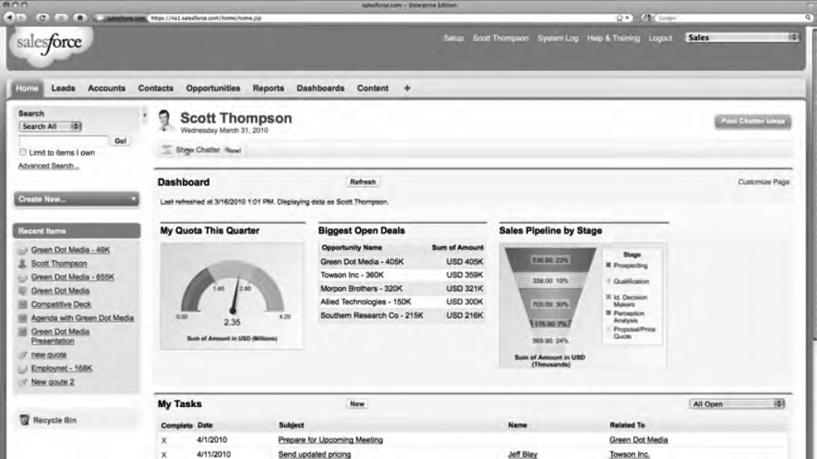
Exploring Paas
Salesforce.com versus Force.com: SaaS versus PaaS
Shown in Figure 7.1 is a Salesforce.com portal with the multi-tabbed interface exposing the different applications.
In Salesforce.com, each tab is an application

Slide 122
PaaS models span a broad ran#e of services, includin# these, amon# others)*
App'(cat("$ )e*e'"pme$t+
$ PaaS platform either provides the means to usepro#rams %ou create in a supported lan#ua#e or o&ers a visual developmentenvironment that writes the code for %ou.*
C"''a"rat("$+
+an% PaaS s%stems are set up to allow multiple individuals towor on the same proects.*
Data ma$aeme$t+
Tools are provided for accessin# and usin# data in a datastore.*
I$trume$tat("$, per"rma$ce, a$) tet($+
Tools are available formeasurin# %our applications and optimi"in# their performance.*
-t"rae+
'ata can be stored in either the PaaS vendor-s service or accessedfrom a thirdpart% stora#e service.*
Tra$act("$ ma$aeme$t+
+an% PaaS s%stems provide services such astransaction mana#ers or broera#e service for maintainin# transaction inte#rit%.
Salesforce.com portal :
Some of the applications included in the site are:
Accounts and Contact
Analytics and Forecasting
Approvals and Workflow
Chatter (Instant Messaging/Collaboration)
Content Library
E-mail and Productivity
Jigsaw Business Data
Marketing and Leads
Opportunities and Quotes
Partner Relationship
Sales
Service and Support

Slide 123
Exploring Paas
Figure 7.2 shows the Force.com platform page at Salesforce.com.
Force.com uses a Java-based programming language called Apex for its application building, and it has an interface builder called Visualforce that allows a developer to create interfaces(reusable UIs) using HTML, Flex, and AJAX.
Using the Force.com platform, more than 1,000 applications have been created and are offered for sale on Salesforce.com’s AppExchange, which has greatly enhanced its PaaS offerings.
These applications can show up as customizable tabs for different functions in customer applications or as a set of S-controls that are JavaScript widgets.
Notes:
While Apex and Java share similar syntax and object-oriented features, Apex is specialized for Salesforce customization and is constrained by Salesforce's environment and governor limits. Java, on the other hand, is a more versatile and general-purpose language used in a wide variety of applications beyond Salesforce.
Interface Builder enables you to create reusable user interface components known as custom views.

Slide 124
Exploring Paas
Figure 7.2 shows the Force.com platform page at Salesforce.com.

Slide 125
Exploring PaaS
Application development
A PaaS provides the tools needed to construct different types of applications that can work together in the same environment.
These are among the common application types:
l Composite business applications
l Data portals
l Mashups of multiple data sources
A mashup is a Web page that displays data from two or more data sources. The various landmarks
and overlays you find in Google Earth, or annotated maps, are examples of mashups.
Notes:
Composite applications are created by combining independent programs, data, and devices. The purpose is to deliver a new solution that was otherwise impossible for independent services to execute.
A data portal is a web application, website, or page of a website that holds data from different sources, organized under subsets or categories to make it simple for the site's users to find.
What is the purpose of a data portal?
A data portal is a software that catalaogs datasets. There are two main types of data portal: open data portals for sharing public data, and internal data portals for sharing data within an organization. They serve as a single “point of truth” for an organisation's data or of data relating to a certain topic.
A Web Mashup is a web application that is aggregated from many other web applications and contains data from different sources merged into a tool

Slide 126
Exploring PaaS
As an application ages, it must be upgraded, migrated, grown, and eventually phased out or ported.
Many PaaS vendors offer systems that are integrated lifecycle development platforms.
That is, the vendor provides a full software development stack for the programmer to use, and it isn’t expected that the developer will need to go outside of the service to create his application.
An integrated lifecycle platform includes the following:
The virtual machine and operating system (often offered by an IaaS)
Data design and storage
A development environment with defined Application Programming Interfaces
Middleware
Testing and optimization tools
Additional tools and services
Google AppEngine, Microsoft Windows Azure Platform, Eccentex AppBase, LongJump, and Wolf
are examples of integrated lifecycle platforms.
Notes:
Basically, VMs are IaaS i.e Infrastructure as a Service as because on a virtual machine you can able to manage what all operations are takes place also what software is installed in it. Whereas PaaS can helps you manage the software that is running in the cloud like app services.
Middleware is software that sits in between user-facing applications and the machine's operating system
coding, integration, testing, delivery, deployment, and feedback.

Slide 127
Paas application Framework
What is the PaaS framework?
Application frameworks provide a means for creating SaaS hosted applications using a unified development environment or an integrated development environment (IDE). PaaS IDEs provides a tool that requires a dedicated programming staff to create and run a graphical interfaces that any knowledgeable computer user can navigate and create something useful with.
the site Squarespace.com was chosen to illustrate a point-and-click CMS system aimed at supporting individuals, small businesses, and other small organizations.
Squarespace is often associated with blogging tools (as is Drupal), but it is more than that. Squarespace works with photos, imports information from other social tools, and allows very attractive Web sites to be created by average users.
Notes:
Instead of writing code from scratch, you can use an SDK, which often consists of libraries, compilers, debuggers, code samples, and documentation. An integrated development environment (IDE) is the software environment you use to connect all the tools bundled in the SDK.
A unified environment provides continuity by connecting multiple disciplines and allowing teams to develop complex, connected products faster

Slide 128
PaaS application Framework
Example PaaS frameworks:
1. Drupal
The Drupal CMS was chosen as an example of this type of PaaS Framework because it is so extensively used and has broad industry impact, and it is a full-strength developer tool. Drupal is an open source content management platform powering millions of websites and applications. It’s built, used, and supported by an active and diverse community of people around the world. Drupal is modular and exposes its functionality through a set of published APIs
The Drupal core by itself contains a number of modules that provide for the following: Auto-updates, Blogs, forums, polls, and RSS feeds, Multiple site management OpenID authentication, Performance optimization, User interface creation tools
Notes:
Content Management System
Drupal is a flexible CMS based on the LAMP stack, with a modular design allowing features to be added and removed by installing and uninstalling modules, and allowing the entire look and feel of the website to be changed by installing and uninstalling themes.

Slide 129
PaaS application Framework
Example PaaS frameworks:
1. Drupal FIGURE 7.3 Artatm.com has a gallery of some of the more attractive and well-known sites built with Drupal

Slide 130
PaaS application Framework
Example PaaS frameworks:
2. Eccentex AppBase 3.0
The Eccentex AppBase (http://www.eccentex.com/platform/platform.html) PaaS application delivery platform creates SOA applications that work on several different IaaS vendors. AppBase includes a set of different tools for building these applications, including the following: Business Objects Build, Presentation Builder, Business Process Designer, Dashboard Designer, Report Builder, Security roles management

Slide 131
PaaS application Framework
Example PaaS frameworks:
2. Eccentex AppBase 3.0
Business Objects Build: This object database has the ability to create rich data objects and create relationships between them. l Presentation Builder: This user interface (UI) builder allows you to drag and drop visual controls for creating Web forms and data entry screens and to include the logic necessary to automate what the user sees. l Business Process Designer: This tool is used to create business logic for your application. With it, you can manage workflow, integrate modules, create rules, and validate data. l Dashboard Designer: This instrumentation tool displays the real-time parameters of your application in a visual form. l Report Builder: This output design tool lets you sort, aggregate, display, and format report information based on the data in your application. l Security Roles Management: This allows you to assign access rights to different objects in the system, to data sets, fields, desktop tabs, and reports. Security roles can be assigned in groups without users, and users can be added later as the application is deployed.

Slide 132
PaaS application Framework
Example PaaS frameworks:
2. Eccentex AppBase 3.0: FIGURE 7.4 The Eccentex ApppBase(http://www.eccentex.com/platform/platform.html) PaaS application delivery platform creates SOA applications that work on several different IaaS vendors

Slide 133
PaaS application Framework
3. Squarespace Squarespace (http://www.squarespace.com/), shown in Figure 7.7, is an example of a next-generation Web site builder and deployment tool that has elements of a PaaS development environment. The applications are built using visual tools and deployed on hosted infrastructure. Squarespace presents itself, among other things, as: A blogging tool A social media integration tool A photo gallery A form builder and data collector An item list manager A traffic and site management and analysis tool
the site Squarespace.com was chosen to illustrate a point-and-click CMS system aimed at supporting individuals, small businesses, and other small organizations.
Squarespace is often associated with blogging tools (as is Drupal), but it is more than that. Squarespace works with photos, imports information from other social tools, and allows very attractive Web sites to be created by average users.

Slide 134
Mini Project sample titles:
Cloud Based Sentiment Analysis
Problem Statement
Aim:
The aim of this project is to develop a scalable and efficient sentiment analysis model for Twitter data by leveraging cloud computing resources.
This model will provide real-time sentiment analysis capabilities for monitoring and analyzing Twitter data streams.
Notes:
Twitter sentiment analysis analyzes the sentiment or emotion of tweets. It uses natural language processing and machine learning algorithms to classify tweets automatically as positive, negative, or neutral based on their content.

Slide 135
Mini Project sample titles:
Objectives:
Collect and preprocess Twitter data using relevant APIs and tools.
Develop a machine learning model for sentiment analysis using natural language processing (NLP) techniques.
Deploy the sentiment analysis model on a cloud computing platform for scalability and real-time processing.
Implement a user-friendly interface for users to interact with the sentiment analysis system
Evaluate the performance of the model in terms of accuracy, scalability, and efficiency.

Slide 136
Mini Project sample titles:
Objectives:
Collect and preprocess Twitter data using relevant APIs and tools.
Develop a machine learning model for sentiment analysis using natural language processing (NLP) techniques.
Deploy the sentiment analysis model on a cloud computing platform for scalability and real-time processing.
Implement a user-friendly interface for users to interact with the sentiment analysis system
Evaluate the performance of the model in terms of accuracy, scalability, and efficiency.

Slide 137
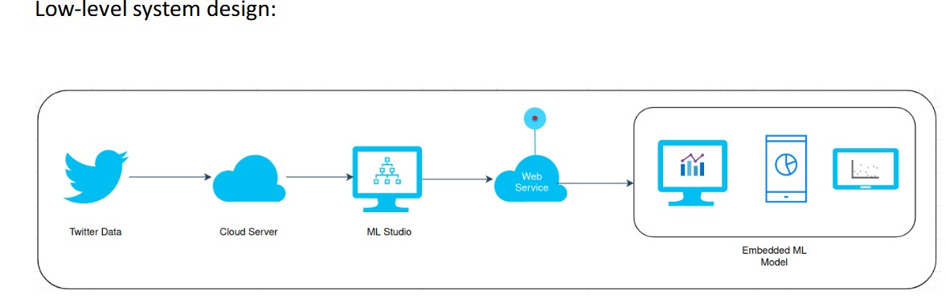
Mini Project sample titles:
Methodology:

Slide 138
Expected Outcome:
A cloud-based Twitter sentiment analysis system capable of processing large volumes of data in real-time.
Improved accuracy in sentiment analysis compared to traditional techniques.
Scalability to handle varying workloads and data influx.
User-friendly interface for easy interaction and visualization of sentiment analysis results.
Insights generated from sentiment analysis to aid decision-making processes for businesses, researchers, and organizations.

Slide 139
Exploring Paas
LongJump provides Platform as a Service (PaaS) which allows non-programmers to design their own applications. Ideally, no programming skills would be needed ... LongJump creates browser-based Web applications that are database-enabled. Like other products mentioned in this section, LongJump comes with an Object Model Viewer, forms, reports, layout tools, dashboards, and site management tools. Access control is based on role- and rule-based access, and it allows for data-sharing between teams and between tenants. LongJump comes with a security policy engine that has user and group privileges, authentication, IP LongJump extends Java and uses a Model-View-Controller architecture (MVC) for its framework in the Developer Suite.
the site Squarespace.com was chosen to illustrate a point-and-click CMS system aimed at supporting individuals, small businesses, and other small organizations.
Squarespace is often associated with blogging tools (as is Drupal), but it is more than that. Squarespace works with photos, imports information from other social tools, and allows very attractive Web sites to be created by average users.
Notes:
An organization assigns a role-based access control role to every employee; the role determines which permissions the system grants to the user. M: data V: viw: C: control logic (separate logic and displaY)

Slide 140
Exploring Paas
the site Squarespace.com was chosen to illustrate a point-and-click CMS system aimed at supporting individuals, small businesses, and other small organizations.
Squarespace is often associated with blogging tools (as is Drupal), but it is more than that. Squarespace works with photos, imports information from other social tools, and allows very attractive Web sites to be created by average users.
the site Squarespace.com was chosen to illustrate a point-and-click CMS system aimed at supporting individuals, small businesses, and other small organizations.

Slide 141
Mini Project sample titles:
2. Build a scalable big data analytics pipeline using AWS EMR (Elastic Map Reduce)
Problem Statement
Aim:
The aim of this project is to develop
Notes:
Twitter sentiment analysis analyzes the sentiment or emotion of tweets. It uses natural language processing and machine learning algorithms to classify tweets automatically as positive, negative, or neutral based on their content.

Slide 142
A Review on Amazon Web Service (AWS), Microsoft Azure
&
Google Cloud Platform (GCP) Services
Due to this advanced technology many services and resources became available for end users,
On the other hand in terms of numbers cloud service provider companies has also shown a rapid growth hence creating competition in the market
It traces a brief history of cloud computing, its usage in the industry, major providers and pricing models used by them
The objective of cloud service providers is to increase profit along with fulfilling objectives of organization and customers' needs
Cloud service providers from types of service like Infrastructure, software, security storage and testing

Slide 143
A Review on Amazon Web Service (AWS), Microsoft Azure
&
Google Cloud Platform (GCP) Services
The benefits of cloud have direct impact on services providers and customers.
The companies like Microsoft, Google, Amazon, Verzion, Rockspace has regularly change pricing scheme to provide more customer friendly service
3 popular Cloud Service Providers Amazon Web Service (AWS) | Microsoft Azure | Google Cloud Platform (GCP)

Slide 144
A Review on Amazon Web Service (AWS), Microsoft Azure
&
Google Cloud Platform (GCP) Services
3 popular Cloud Service Providers Amazon Web Service (AWS) | Microsoft Azure | Google Cloud Platform (GCP)
Amazon web Services (AWS) is one of the oldest players in the market it was started in 2006.
As AWS is one of the oldest cloud platforms in the market and is one of the famous cloud platforms available. So AWS is widely available. Amazon web Services (AWS) has 63 availability zones worldwide
Google cloud platform (GCP) launched in in 2011 by Google to provide cloud computing services to its customers. Services provided by GCP includes storage, big data ,databases, analytics, cloud AI, Network, mobile computing, development tools, management tools, Internet of things, cloud security and data transfer. Google cloud platform (GCP) has 21 availability zones worldwide
Notes:
Windows azure 2010, Microsoft azure in 2014
Azure availability zones are physically and logically separated datacenters with their own independent power source, network, and cooling. Availability Zones enable you to operate production applications and databases that are more highly available, fault tolerant, and scalable than possible when using a single data center.

Slide 145
A Review on Amazon Web Service (AWS), Microsoft Azure
&
Google Cloud Platform (GCP) Services
The graph in figure 6 represents the growth among three cloud service platforms in last 5 years (2015 to 2019)
It is clearly visible that in last 5 years the popularity of Amazon Web Services (AWS) has surpassed Microsoft Azure and Google cloud platform (GCP) worldwide

Slide 146
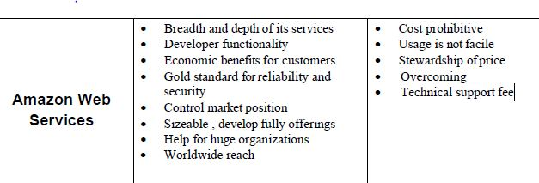
A Review on Amazon Web Service (AWS), Microsoft Azure
&
Google Cloud Platform (GCP) Services
Cloud Service
Providers Benefits Limitations
Notes:
High cost, not easy

Slide 147
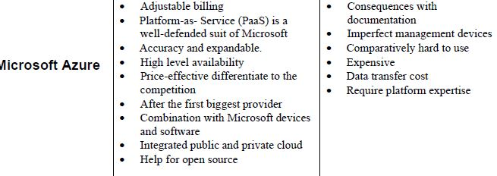
A Review on Amazon Web Service (AWS), Microsoft Azure
&
Google Cloud Platform (GCP) Services
Cloud Service
Providers Benefits Limitations

Slide 148
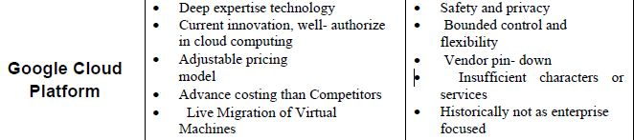
A Review on Amazon Web Service (AWS), Microsoft Azure
&
Google Cloud Platform (GCP) Services
Cloud Service
Providers Benefits Limitations

Slide 149
